Slide 1
Brocade
Phillip Coates
pcoates@brocade.com
Bob DeHaan
rdehaan@brocade.com
Notes:
Welcome…
Introductions…
Today I would like to talk about some industry trends and how Brocade can help you build a networking infrastructure that aligns with your business requirements and provides a strategic path for continued growth.
I will also share the strategic Brocade vision and how we can help you achieve the benefits of that vision.

Slide 2
Legal Disclaimer
All or some of the products detailed in this presentation may still be under development and certain specifications, including but not limited to, release dates, prices, and product features, may change. The products may not function as intended and a production version of the products may never be released. Even if a production version is released, it may be materially different from the pre-release version discussed in this presentation.
Nothing in this presentation shall be deemed to create a warranty of any kind, either express or implied, statutory or otherwise, including but not limited to, any implied warranties of merchantability, fitness for a particular purpose, or noninfringement of third-party rights with respect to any products and services referenced herein.
Brocade, the B-wing symbol, DCX, Fabric OS, and SAN Health are registered trademarks, and Brocade Assurance, Brocade NET Health, Brocade One, CloudPlex, MLX, VCS, VDX, and When the Mission Is Critical, the Network Is Brocade are trademarks of Brocade Communications Systems, Inc., in the United States and/or in other countries. Other brands, products, or service names mentioned are or may be trademarks or service marks of their respective owners.
2/325

Slide 3
Agenda
Brocade Overview
To (network) converge or not
Ethernet fabrics – converged or not
Fibre Channel
Ethernet
Application delivery – L4-7
Management + 3rd party integration
Server connections

Slide 4
The Brocade Advantage
Helping you achieve your business objectives
Data center-class availability
30 to 50% lower total cost
of ownership
Simplified management
Extensive partner ecosystem
Unified wired and wireless networks
Optimized
Applications
Investment Protection
Non-Stop Networking
Unmatched Simplicity
Notes:
Key Takeaways:
Brocade helps customers achieve their business objectives by delivering:
Data center-class availability (> five 9”s)
30% to 50% lower TCO vs competing vendor’s solutions
Simplified (unified) management using an industry standard command line interface
Access to an extensive partner eco-system which allows Brocade to deliver “best in class” solutions
Market leading wired/wireless security
Speaker Notes:
Brocade is the right company to help you transition your network into a business enabler and a strategic asset for the organization and achieve you business objectives.
Brocade’s heritage is in the data center and as a result data center requirements for availability and performance are in our DNA. All of Brocade’s solutions deliver data center-class availability to support our customers’ increasing requirements for continuous uptime by setting the standards for;
continuous operation
ease-of-management, and
cost effective resiliency
As we mentioned, our solutions emphasize migration, evolution and extensions to build upon your infrastructure. Our products and solutions are built on open standards interfaces and can operate in any multi-vendor environment. We deliver performance at a reasonable price. These attributes allow us to deliver Brocade solutions at a 30% - 50% lower total cost of ownership than competing vendor’s solutions.
Brocade simplifies network management with a highly scalable unified management approach. We have a unified network management system across all wired and wireless products. We also provide northbound trap and event support to a variety of 3rd party network management systems in addition to utliziing an industry standard command line interface – eliminating the learning curve on Brocade products.
We understand that your enterprise network is not a monolithic entity and that it requires a variety of solutions to make it work. That’s why we have a broad ecosystem of industry-leading partners that bring you best-in-class technologies, solutions, and support.
We believe that open standards and strong relationships with the world’s largest IT companies provide the best solution for your infrastructure needs. That means no proprietary solutions and no need to rip and replace your existing infrastructure. It means solutions that are backward and forward compatible with your current solutions.
The companies you see on this slide represent over 10 years of strategic partnerships with Brocade. And we have invested more than $1B in joint development and testing with these world-class technology companies.
The advantage to you is the greatest choice and flexibility to build networking infrastructures that are open, heterogeneous, and best in class.
Through our partner eco-system Brocade provides market leading wired/wireless security. Our partnerships allow us to offer the industry’s best security offerings that provide a complete and competitive Best-of-Class offering to customers.
We provide end to end networking and security solutions, from the edge to core to the data center. Pre-emptive security that defensively protects your organization before damage can occur and improve productivity by freeing your IT resources to focus on strategic risk management initiatives. We reduce business risk and improve compliance by providing for support for federal, state and industry security regulations.

Slide 5


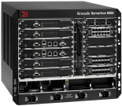









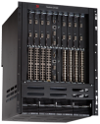



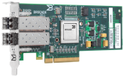

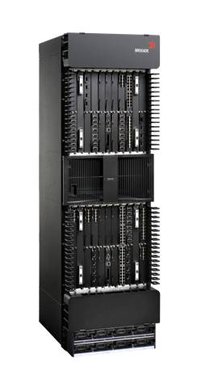
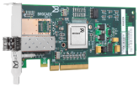


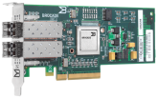



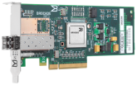


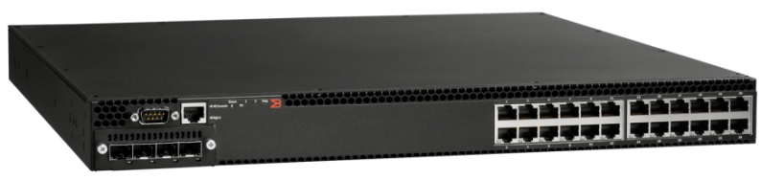


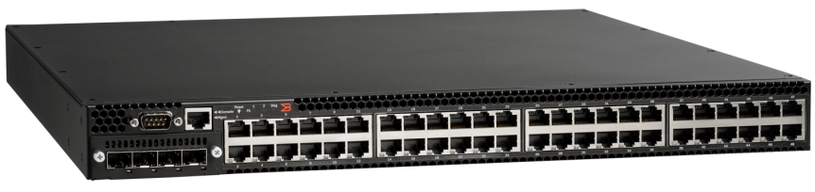










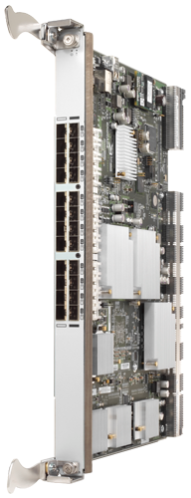

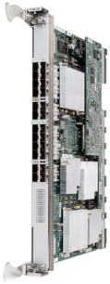
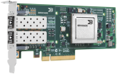

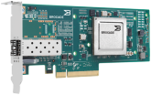





Brocade Product Portfolio
Metro / SP
FastIron WS Series
NetIron CES/CER Series
Brocade Mobility Series
ServerIron ADX
Series
Enterprise Campus LAN
L2 – 3 (Wired + Wireless)
FastIron SX Series
415/425 HBA
Blade Server Switches
FCX Series
300 Switch
815/825 HBA
5100 Switch
NetIron MLX and MLXe Series
FCX Series
VA-40FC Switch
L2 - 3
DCX Backbones
Data Center SAN
Data Center LAN
VDX 6720 Data Center Switches
FC8-16, -32, -48, -64
Switch Blade
5300 Switch
TurboIron 24X
BigIron RX Series
7600 App. Switch
ServerIron
ADX
Series
7800 Extension Switch
L4 - 7
1010/1020 CNA
FCOE10-24
Blade
FS8 -18
Encryption
Blade
FX8-24
Extension
Blade
8000 Switch
Encryption Switch
Ethernet/IP
DCB/FCoE
Fibre Channel
Brocade Network Advisor
Plug-ins and Integration

Slide 6
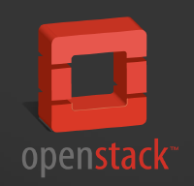








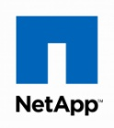


There is only ONE Company with 10+ years Compute and Storage Relationships and Fabric Experience
Cloudplex reference architectures
HYPERVISOR/
FRAMEWORKS
COMPUTE
Brocade Fabrics
NETWORK
STORAGE
Notes:
Brocade is not alone in helping you make this transition.
We understanding the reality of complex environments and your desire to work with the best vendors in the industry.
Brocade has always been a partner-focused company. We work with the world’s leading IT companies to validate and deliver truly best-in-class solutions.
As a result, you have the flexibility and choice to use whatever products you want.
Where other vendors deliver solutions notable by their limitations…Brocade enables choice by drawing on innovation and the industry’s largest ecosystem of strategic partnerships.
Seamless migration to a common management interface
Comprehensive interoperability lab
Leading converged network offering
More robust partner ecosystem
November 2010: Extended strategic partnership with VMware
February 2010: Formed strategic partnership with McAfee
September 2009: Extended OEM agreement with Dell to include Ethernet solutions
April 2009: Extended OEM agreement with IBM to include Ethernet solutions
April 2000: Formed storage OEM agreement with EMC
March 2000: Formed storage OEM agreement with IBM
February 2000: Formed storage OEM agreement with HP

Slide 7
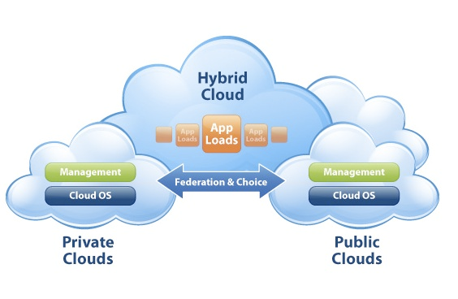
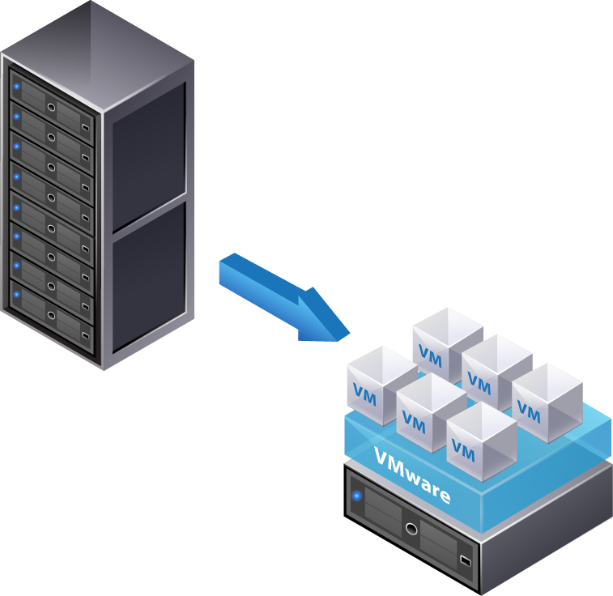
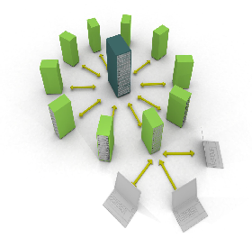
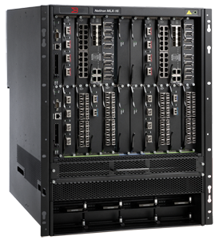
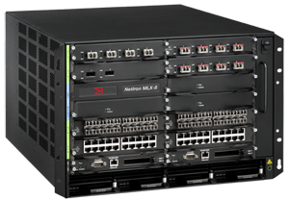
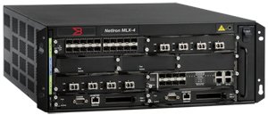
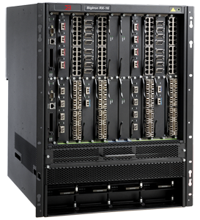
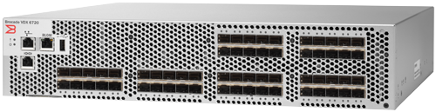
Data Centre Access Solutions
Cloud
3 Architectural Solutions for each stage
Virtualization
Consolidation
Core
MLX
Access
RX
768
1 GbE
VDX
24/60 10GbE
TurboIron*
24 10 GbE
MLX
1,536
1 GbE
RX
256
10 GbE
MLX
256
10 GbE
FCX**
48 1 GbE
1. Architecting Consolidated DC with Dense 1 GbE Server Access
2. Architecting Virtualized DC with Dense 10 GbE Server Access
3. Architecting Virtualized/Cloud DC with 1/10 GbE Server Access
VToR Architecture
End of Row Architecture
Top of Rack Architecture

Slide 8







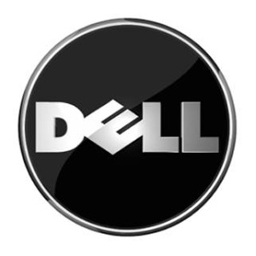






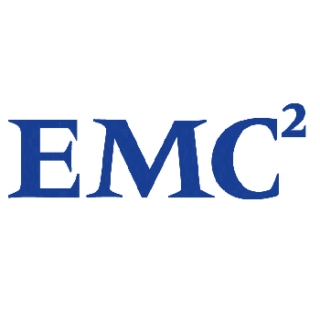

Brocade Data Center Product Portfolio
Core
Brocade
MLX
1 GbE
4 Gbps FC
8/16 Gbps FC
10 Gbps DCB
10 GbE
WAN
Aggregation
Brocade RX
Brocade Application Delivery
Brocade
MLX
8 Gbps DCX Backbone
Tape
Libraries
Disk Arrays
Access
8 Gbps DCX4S/
48000/5300/5100
GbEToR
FCX
1/10 GbEToR
1/10 GbEEoR RX
DCB/FCoE
Brocade 8000
TurboIron
Brocade
VCS
Servers
NAS
Notes:
Use this slide to show existing LAN and Brocade One are part of an evolutionary architecture preserving investment and scaling virtualized data center for the future.
VCS gives frictionless Layer 2 scaling for VM while ADC will support automated scaling of application resources for the virtual infrastructure. Can lead to ADX preso

Slide 9

CLOUDPLEX
OPEN
Enable multi-vendor solutions
Customer choice of technologies
Investment protection
Faster innovation
9/22/2011
Notes:
Getting to this vision of the virtual enterprise is a fundamentally heterogeneous problem – no one vendor is big enough to build everything from end to end. Nor is it necessary or in customers best interest.
So the active drive to open systems and standards is one of the fundamental tenants of CloudPlex.
Open standards will enable the construction of these multi-vendor solutions. Enable customers to choose best of breed technologies. Allow use of the installed base of assets. And ultimately, speed innovation because every vendor that doesn’t innovate gets replaced by a higher value partner.

Slide 10
What is CloudPlex?
SAN JOSE, CA -- (Marketwire) -05/03/2011 -- Brocade (NASDAQ: BRCD) today introduced a new technology architecture that outlines the company's vision and the technology investments it will make to help its customers evolve their data centers and IT resources and migrate them to the "Virtual Enterprise.“
An architecture for merging public, private and hybrid clouds over time.
Not a PRODUCT but a NEW CLOUD TECHNOLOGY
ARCHITECTURE
Note: Following slides are not for distribution (yet)

Slide 11
What makes CLOUDPLEX UNIQUE?
What is unique about the Brocade CLOUDPLEX architecture is the multi-vendor, standards- and fabric-based architecture which drives CONSTANT COST REDUCTION
by DESIGN
while – over time - delivering the same BUSINESS AGILITY as single vendor architectures
Multi-vendor
Standards- based
Fabric-based

Slide 12

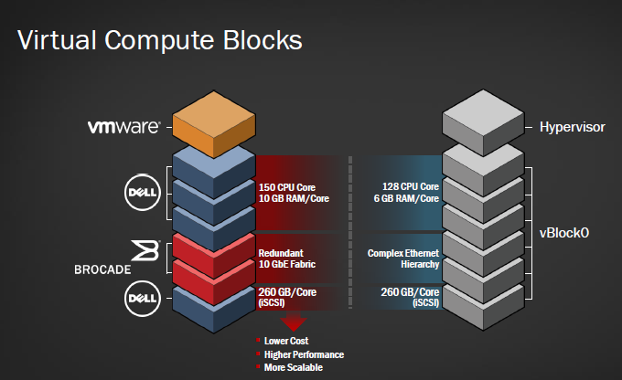
What are Virtual Compute Blocks?
Integrated, tested and validated solution bundles of server, virtualization, networking and storage resources called Brocade Virtual Compute Blocks delivered by Brocade’s systems partners and integrators in pre-bundled, pre-racked configurations with unified support.
Brocade Press Release: Brocade Unveils Vision for the Virtual Enterprise, May 3 2011

Slide 13
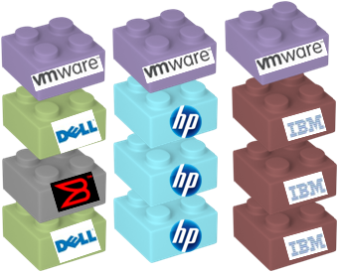
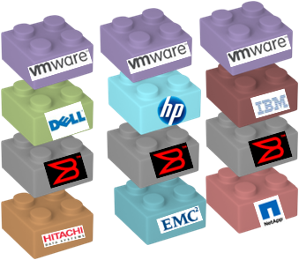


There is a market for both versions of Virtual Compute Blocks
“Best-of-Breed” Stack
on every layer
“Single”-Vendor Stack
...others
...others
Comfortable to “put all eggs in
one basket”
Always enforces dual vendor strategy
Has been “burned” by vendor lock in

Slide 14

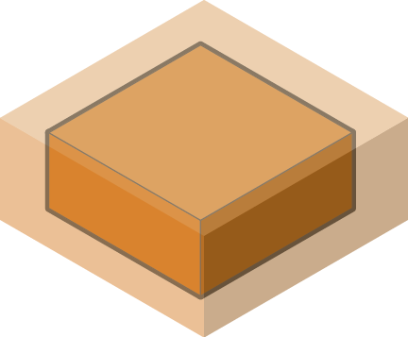


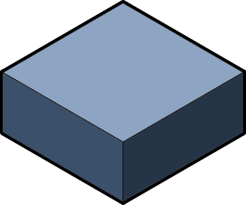
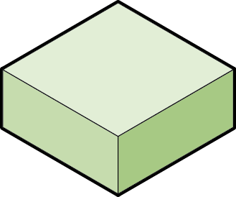
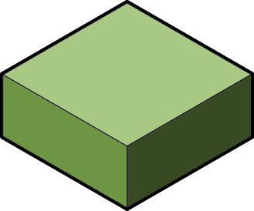
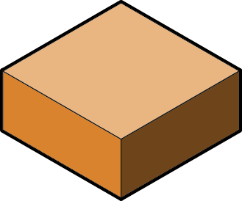
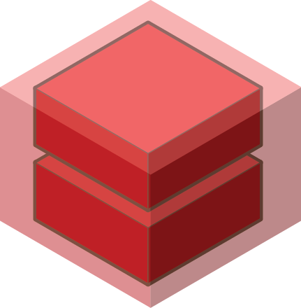
Scaling Virtual Compute Blocks
Notes:
How do they scale? Simply by adding a second rack and then connecting the fabric elements together.
What you get is a single logical, flat, high-speed network and a mobility domain for VMs that extends automatically and seamlessly across both racks.
And I can continue this process, one rack at a time, incorporating other servers, other storage, I can mix iSCSI, FCoE, NAS, and native FC – all by simply interconnecting fabric elements.

Slide 15


DATA CENTER FABRICS
Fibre Channel
Fabrics
Ethernet
Fabrics
© 2011 Brocade Communications Systems, Inc. Proprietary Information
9/22/2011
15
Notes:
Brocade’s strategy to help customers innovate in their data centers is to deliver fabric technology for both storage and Ethernet networking.
Fundamental belief is that in order for data centers to accommodate the rigorous requirements of virtualization and cloud architectures, they must realize the benefits of fabric-based solutions.
The remainder of my presentation on fibre channel storage fabrics and then will ask Doug Ingraham to provide you with an update on our vision, progress to-date and strategy for our continued leadership in Ethernet fabrics.

Slide 16

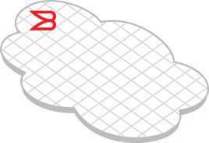
Data Center Network Evolution
Today
NIC
HBA
LAN
SAN
Servers
Servers
Storage
Ethernet LAN for non-storage (IP) traffic
Fibre Channel SAN for storage (FC) traffic
Notes:
< SLIDE HIGHLIGHT: The Data Center Network is evolving>
So let's shift gears a bit and talk about infrastructure and an evolution taking place in network connectivity.
Here we have a simple logical construct of the data center network today. In the center we have servers connected to clients or other servers via the Ethernet LAN and to shared storage devices via a Fibre Channel SAN. Conventional NICs (network interface cards) are used to connect to the LAN and HBAs (host bus adapters) are used to connect to the SAN. As depicted on the left side of the diagram, we also have servers that don’t require access to shared storage and thus are connected only to the LAN.

Slide 17
Data Center Network Evolution
2009
New Tier 2, 3 Windows and Linux Servers
DCB/FCoE at Access Layer
CNA
Server I/O Consolidation
LAN
SAN
Ethernet
FC
Existing servers
with only non-storage
traffic
Storage
NIC
HBA
Existing W/L; Unix, Mainframe
Data Center Bridging (DCB) for IP and storage (FCoE) traffic
Ethernet LAN for IP-only traffic
Fibre Channel SAN for storage-only (FC) traffic
Notes:
< SLIDE HIGHLIGHT: Clarity and value behind CEE/FCoE technologies - >
So what’s changing? Server I/O consolidation and the first 5 feet into the network.
Two new protocols – CEE (Converged Enhanced Ethernet) and FCoE (Fibre Channel Over Ethernet) – have been developed to enable both storage (FC) and non-storage (IP) traffic to travel over a common 10 Gbps pipe. The key value today is at the server connection in the rack .
First, a CNA or Converged Network Adapter is used in place of a NIC and HBA. A common cable is used in place of both Ethernet and Fibre channel cabling. And a common switch is used at the access layer in place of separate Ethernet and Fibre Channel switches. Thus server connections, cabling, and switch ports in the rack are reduced by half, resulting in capital and operating cost saving, as well as greater energy efficiency through improved airflow (due to less cabling).
A couple of things to note. CEE is a completely new form of Ethernet developed to provide a lossless, low latency, deterministic transport for storage traffic– in others words, to perform like Fibre Channel. (One important difference CEE has over conventional Ethernet is not allowing dropped frames, which would cause data corruption. TCP addresses this need for conventional Ethernet, though with considerable overhead.) FCoE is an encapsulation protocol – Fibre Channel traffic is encapsulated to run over CEE. (Note: the Fibre Channel protocol encapsulates SCSI packets for transport over a Fibre Channel connection; FCoE is an additional encapsulation protocol).
When traffic arrives at a common switch – let’s call it a CEE/FCoE switch – IP traffic is forwarded to the LAN and FC traffic (after it’s de-capsulated) is forwarded to the SAN. The CEE/FCoE switch effectively straddles both the LAN and the SAN. That's true of all CEE and FCOE technology in the industry. It's true of our CEE/FCOE technology. It's true of Cisco's DCE/FCOE technology.
Note that the benefits of CEE/FCoE are realized in “green-field” server environments with storage requirements. It’s not cost-effective to rip out existing cabling and replace NICs and HBAs with CNAs, nor connect servers over CEE without storage requirements.
In 2009, we see most customers testing CEE/FCoE capabilities and functionality in labs vs. using in production environments, and limiting to tier 3 and possibly tier 2 applications. Basically a time to get your feet wet and gain confidence in the new technology. FCOE is at the final stage of ratification (T11 standards body) and we expect CEE to also complete ratification n 2009 (IEEE) as well.

Slide 18
Data Center Network Evolution
2010
New Tier 2, 3 Windows and Linux Servers
DCB Expands to LAN Core
CNA
Server I/O Consolidation
LAN
SAN
Ethernet
FC
Ethernet $ < CEE $
Front-end app servers
Mgmt servers
LAN-based backup
Campus LAN access
(non-storage traffic)
Storage
NIC
HBA
Existing, Tier 1 W/L; Unix, Mainframe
Data Center Bridging (DCB) for IP and storage (FCoE) traffic
Ethernet LAN for IP-only traffic
Fibre Channel SAN for storage-only (FC) traffic
Notes:
< SLIDE HIGHLIGHT: In 2010, CEE/FCoE begins to move from test environments to select types production environments, but conventional Ethernet remains and FC SANs grow >
As we move to 2010, we expect to see the first implementations of CEE/FCoE solutions in production environments and green-field server installations. Note that at least through 2010, CEE and FCoE will only be supported for Windows and Linux servers – Unix, Mainframe, existing W/L servers, and Tier 1 W/L servers will have conventional Ethernet and FC connections. (we don’t expect customers will have the level of confidence to use CEE/FCoE for Tier 1 apps).
We also see CEE/FCoE adoption causing Fibre Channel SANs to grow, and for two main reasons. The first reason is storage access – now all servers in the rack have SAN access. Couple that with server virtualization and the need for shared storage and SAN connectivity increases. The second reason is native performance. Keep in mind FCoE is an encapsulation protocol that adds some amount of overhead. Because native FC connectivity will still deliver greater performance, the value of direct CEE/FCoE connections on storage arrays is questionable at this time. NetApp has introduced CEE/FCoE connected storage, but this maps to a NAS/LAN topology. EMC has announced future CEE/FCoE connectivity in 2010, but adoption is unclear.
In any event, SANs based on native Fibre Channel switching will continue for many years. Note that conventional Ethernet (GigE and 10GigE) will also continue for years as conventional Ethernet will prove more-cost effective than CEE for servers that don’t need storage access (front-end web servers, front-end Exchange servers, mgmt servers, LAN-based backup, etc).

Slide 19
Data Center Network Evolution
Today 2010 …
DCB and FCoE can deliver CapEx and OpEx savings through consolidation of Windows/Linux server I/O
DCB/FCoE requires deep expertise from network vendors in both IP and Fibre Channel
Brocade offers the flexibility of industry-leading connectivity solutions
  Ethernet, Fibre Channel, and DCB/FCoE will co-exist to meet differing customer needs
Notes:
< SLIDE HIGHLIGHT: Brocade’s expertise and broad solution portfolio allows customers to select Conventional Ethernet, Fibre Channel, or CEE/FCoE connectivity to meet their specific environmental needs.
(Note re bullet 3 – only two network vendors have that level of expertise – Brocade and Cisco).
19

Slide 20
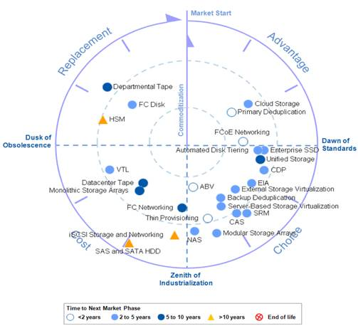
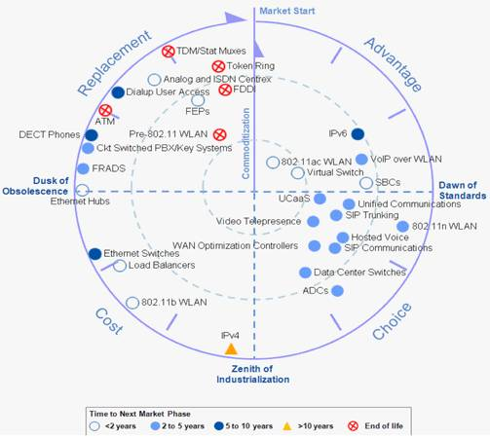
Traditional Ethernet, Fibre Channel and FCoE – what future?
Fibre Channel over Ethernet (DCB)
- The Dawn of Standards
Fibre Channel over Ethernet (DCB)
- The Dawn of Standards
Traditional Ethernet
- near the Dusk of obsolescence
Gartner’s IT Market Clock for storage technologies. This series of reports highlights the progress of IT products and services from the time they first become viable to deploy and use, to the time when they must be retired. In this report, Gartner says Fibre Channel has just reached the “Zenith of Industrialization” with a time horizon of five to 10 years before it reaches the next phase of the lifecycle. [September 2011]
Gartner’s IT Market Clock for Enterprise Networking that various networking technologies in their technology lifecycles [September 2010]

Slide 21
Open Standards & Customer Choice
We make FAST chips that ship FAST bits & the Tools to manage them
FC, FCoE, iSCSI, or NAS? This is Your Business Decision
We are Protocol & Hypervisor Agnostic
Which Servers & Storage you use is YOUR choice
Simpler, Better & Quicker
Notes:
We want to provide every system, every device the fastest easiest access to your storage.

Slide 22

Virtual Cluster Switching (VCS) Details
CTO Edge’s 2010 Enterprise product of the year! http://www.ctoedge.com/content/2010-ten-most-important-enterprise-it-products
The VDX ‘heralds a change in the way we think about managing data centers for years to come’.

Slide 23
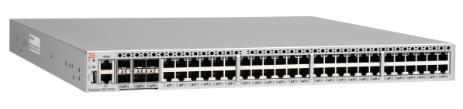

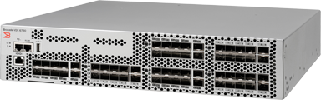
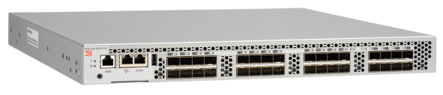
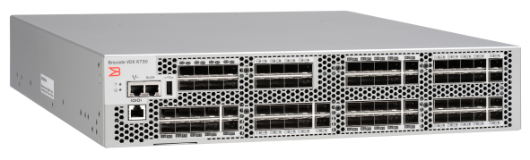
Brocade VDX product family
The Flexible Choice for the Evolving Data Center
NEW!
Brocade VDX 6710 Switch
Ideal for every stage of network evolution
Ultra-low latency for unmatched performance
Superior size and power efficiency critical for today’s data center
      Flexible storage connectivity for FCoE, iSCSI, and NAS
Brocade VDX 6720 Switch
NEW!
Brocade VDX 6730 Switch

Slide 24
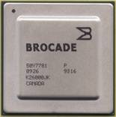
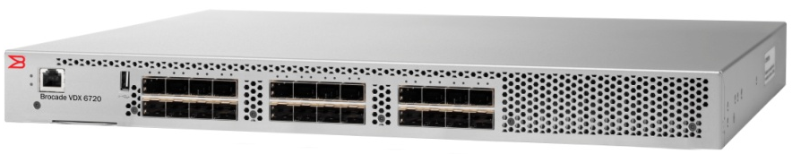
Brocade VDX 6720 Data Center Switches
Product highlights
Built for the Virtual Data Center
  Uses Brocade fabric switching ASICs
  First switches to run new Brocade Network Operating System
  Virtual Cluster Switching (VCS) fabric technology
  Automatic Migration of Port Profiles (AMPP)
Best-In-Class Performance and Density
  24- and 60-port models
  Non-blocking, cut-through architecture, wire-speed
  600 ns port-to-port latency; 1.8 us across port groups
Environmental Flexibility
  10 GbE and 1 GbE supported on every port
  Twinax, direct-attached optical, and SFP optical connectivity options
  Less than 17” switch depth and reversible front-to-back airflow
Enables Network Convergence
  Complete FCoE support, multi-hop
  iSCSI DCB support
Highly Resilient and Efficient Design
  Hot code load and activation
  Remote Lights Out Management
  Simplistic design, optimal power efficiency
Notes:
24

Slide 25
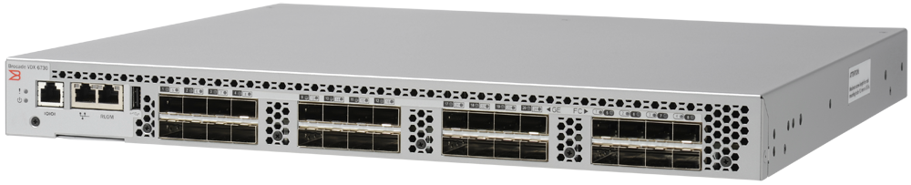
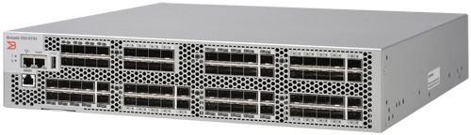
Brocade VDX 6730 Data Center Switches
Product details
Leading Performance and Density
  32- and 76-port models with Ports on Demand (PoD)
  Brocade VDX 6730-32
    Compact 1U form factor; 24 1/10 Gbps SFP+ ports;
    8 2/4/8 Gbps Fibre Channel ports
  Brocade VDX 6730-76
    2U form factor; 60 1/10 Gbps SFP+ ports; 16 2/4/8 Gbps Fibre Channel ports
  Non-blocking, cut-through architecture, wire-speed
  600 ns port-to-port latency; 1.8 μs across port groups
Unified Storage Connectivity
  Ethernet storage connectivity for FCoE, iSCSI, and NAS storage
  Multihop FCoE and iSCSI Data Center Bridging (DCB) support
Environmental Flexibility
  10 Gbps and 1 Gbps supported on every LAN port; 2,4, and 8 Gbps on SAN port
  Direct-attached copper and SFP optical connectivity options
  Switch depth less than 17 inches; reversible front-to-back airflow
Highly Resilient and Efficient Design
  Brocade Fabric Watch provides proactive monitoring and notification of critical switch component failure
  Simplistic design for better MTBF and optimal power efficiency
Brocade VDX 6730-32
Brocade VDX 6730-76
Notes:
25
Key Points
Highlight of the VDX 6720 switches.

Slide 26
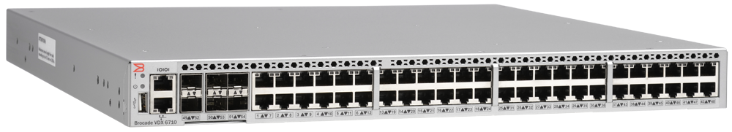
Brocade VDX 6710 Data Center Switches
Product details
Leading Performance and Density
  Brocade VDX 6710-54
    Compact 1U form factor; 6 1/10 Gbps SFP+ ports;
    48 1 Gbps RJ45 copper ports
  Non-blocking, cut-through architecture, wire-speed
  600 ns port-to-port latency; 1.8 μs across port groups
Environmental Flexibility
  Switch depth less than 17 inches; reversible front-to-back airflow
  Two internal, redundant, field-replaceable, load-sharing AC power supplies
Highly Resilient and Efficient Design
  Brocade Fabric Watch provides proactive monitoring and notification of critical switch component failure
  Simplistic design for better MTBF and optimal power efficiency
Brocade VDX 6710-54
Notes:
26
Key Points
Highlight of the VDX 6710 switches.
Cost Effective 1 GbE server connectivity: Brocade VDX 6710 allows customers to extend the benefits of an Ethernet fabric to existing 1 GbE servers. It is a high-performance 1 GbE fixed port switch that provides a reliable, scalable, and flexible foundation to support demanding applications. The VDX 6710 switch has 48 1GbE Copper Interfaces and 6 10GbE SFP+ interfaces.
Provide a reliable, scalable, and flexible foundation for Ethernet fabrics: Brocade VDX 6710 supports a build as you grow model. Form an Ethernet fabric initially with two switches and scale to larger clusters for cost-effective connectivity to 1 GbE servers.
Build a resilient, fast network optimized for performance-demanding environments:
Local switching delivers high performance for intra-rack traffic in virtualized environment providing ultra-low latency of 600 ns for same ASIC and 1.8 ns across ASICs on the same switch. This helps in designing a network with no over-subscription for deterministic network performance and improved application response time
VDX6710 will support multiple deployment models.
Classic 1 GbE access. Delivers classic 1 GbE ToR access deployments with a broad set of Layer 2 features.
Scale-out fabrics for virtualized data centers. Enables dynamic, large-scale, server virtualization deployments in private (IT customers within an organization) and public (external customers of managed service provider) clouds with proven fabric capabilities and Layer 2 Equal Cost Multipath Protocol (ECMP).

Slide 27
3 VCS / VDX Use Models
Tailored adoption strategies for our customers
Classic Ethernet
Switch pair at the Top of each Server Rack
Large Scale Server Virtualization
Collapsed, Flat L2 networks enabling Virtual Machine Mobility
Convergence
Shared storage access, End to End FCoE
Classic Model
Ethernet Fabric Model
Convergence Model

Slide 28
Brocade Virtual Cluster Switching (VCS)
Revolutionizes Layer 2 connectivity
Increases scalability of virtual server environments and sphere of mobility
Maximizes network performance—reduces network complexity
VCS

Slide 29
Virtual Cluster Switching (VCS)
VCS
Logically flattens and collapses network layers
Scale edge and manage as if single switch
Auto-configuration
Centralized or distributed mgmt
Ethernet Fabric
Distributed Intelligence
Logical
Chassis
No Spanning Tree Protocol
Multi-path, deterministic
Auto-healing, non-disruptive
Lossless, low latency
Convergence-ready
Self-forming
Arbitrary topology
Fabric is aware of all members, devices, VMs
Masterless control, no reconfiguration
Dynamic Services
Connectivity over Distance, Native Fibre Channel,
Security Services, Layer 4-7, etc.
Notes:
Key Points
Brocade Virtual Cluster Switching (VCS) is a revolutionary layer 2 Ethernet technology that raises network utilization, maximizes application availability, increases scalability, and drastically simplifies the network architecture in next-generation virtualized data centers.
VCS is comprises of three main pillars of innovation; Ethernet Fabric, Distributed Intelligence, and Logical Chassis.
The VCS architecture is designed to incorporate a set of Dynamic Services for the highest level of functionality and investment protection, making it a core building block for virtualizing the data center network.
Ethernet Fabric
Brocade pioneered the development, architecture, and deployment of network fabric technology in the data center. Brocade’s SAN fabric technology is successfully proven in over 90% of the Global 1000 data centers. Now Brocade is bringing the same level of innovation to the data center LAN, combining Ethernet and Brocade fabric technology.
STP is not necessary because the Ethernet fabric appears as a single logical switch to connected servers, devices, and the rest of the network.
The Ethernet fabric is an advanced multi-path network utilizing an emerging standard called TRILL (Transparent Interconnect of Lots of Links). Unlike STP, with TRILL, all paths in the network are active and traffic is distributed across those equal cost paths automatically. In this optimized environment, traffic automatically takes the shortest path for minimum latency without any manual configuration.
Events like added, removed, or failed links are not disruptive to the Ethernet fabric and do not require all traffic in the fabric to stop. If a single link fails, traffic is automatically rerouted to other available paths in under a second. Single component failures do not require the entire fabric topology to reconverge, ensuring all traffic is not affected by an isolated issue. The fabric is lossless and low latency.
The Ethernet fabric is designed to include advanced Ethernet technology for higher utilization, greater performance, and to be network convergence ready. With Data Center Bridging (DCB) capabilities built-in, the Ethernet fabric is lossless, making it ideal for FCoE and iSCSI storage traffic and will enable LAN and SAN convergence for Tier 2 and 3 applications.
Distributed Intelligence
With VCS, all configuration and end device information is automatically distributed to each member switch in the fabric.
The Ethernet fabric is self forming. When two VCS-enabled switches are connected, the fabric is automatically created and the switches learn the common fabric configuration.
The Ethernet fabric does not dictate any specific topology, so it does not restrict over-subscription ratios. This allows the architect to create a topology that best meets application requirements.
The fabric is aware of all members, devices, and VMs. When a server connects to the fabric for the first time, all switches in the fabric learn about that server. This allows for fabric switches to be added or removed and for physical or virtual servers to be relocated, without the fabric needing to be manually reconfigured.
Unlike switch stacking technologies, the Ethernet fabric is masterless. This means that no single switch stores configuration information or controls fabric operations.
Distributed Intelligence supports a more virtualized access layer. Instead of distributed software switch functionality to exist in the virtualization hypervisor, access layer switching is done in the switch hardware, improving performance, ensuring consistent and correct security policies, and simplifying network operations and management. Automatic Migration of Port Profiles (AMPP) supports VM migrations to another physical server, ensuring that the source and destination network ports will have the same configuration for the VM. This is key technology that helps enable Brocade Virtual Access Layer (VAL) capabilities.
Logical Chassis
All switches in an Ethernet fabric are managed as if they were a single Logical Chassis. The network just sees the fabric as a single switch, no matter if the fabric contains a little as 48 ports, or thousands of ports.
The Ethernet fabric is designed to scale over 1000 ports per Logical Chassis. Consequently, VCS removes the need for separate aggregation switches because the fabric is self-aggregating. This enables the network architecture to be flattened, dramatically reducing cost and management complexity.
Each physical switch in the fabric is managed as if it were a port module in a chassis. This allows for fabric scalability without manual configuration. When you add a port module to a chassis, you do not have to configure that module, and a switch can be added to the Ethernet fabric just as easily.
The logical chassis functionality drastically reduces management of small-form-factor edge switches. Instead of managing each top-of-rack switch or switches in blade server chassis individually, they are managed as one Logical Chassis.
Dynamic Services
Dynamic Services extends the capabilities of VCS for maximum investment protection and to incrementally incorporate new network services. A Dynamic Service behaves like a special service module in a modular chassis.
Examples of these services are fabric extension over distance, native Fibre Channel connectivity, Layer 4-7 services such as Brocade’s Application Resource Broker, and enhanced security services such as firewalls and data encryption.
Switches with these unique capabilities can be added to the Ethernet fabric, adding a network service layer available across the entire fabric.

Slide 30
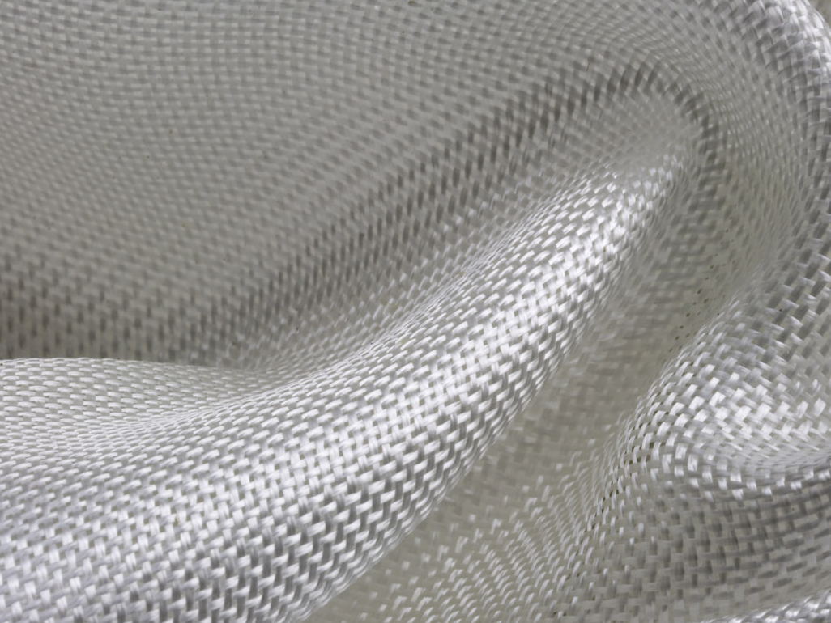
WHY ETHERNET FABRIC?
Effortless Connectivity—
Better Service Delivery
  Resilient
  Flexible topology
  Scalable/elastic
  Flat architecture
Future-proof
Data Center
Networks
Network Automation —
Simpler Service Orchestration
  Logical chassis, domain-based management
  Automatic VM alignment
  FCoE traffic to FC SAN for seamless DC network
Notes:
As we have talked about here today, existing IT architectures are not appropriate for this new world of high-performance, low-energy, resilient, deterministic networking
Networks MUST move to a cloud-optimized architecture in order to achieve the performance, scale and simplicity that next-generation networking demands.
The SINGLE MOST CRITICAL component of a cloud-optimized infrastructure is the FABRIC.
Unlike classic hierarchical architectures, in fabric-based networks every point is physically connected to every other point, enabling better availability, scalability and utilization:
Resilient without being redundant
Low latency while scaling massively
Increased bandwidth with multi-pathing
Inherently flat and efficient

Slide 31
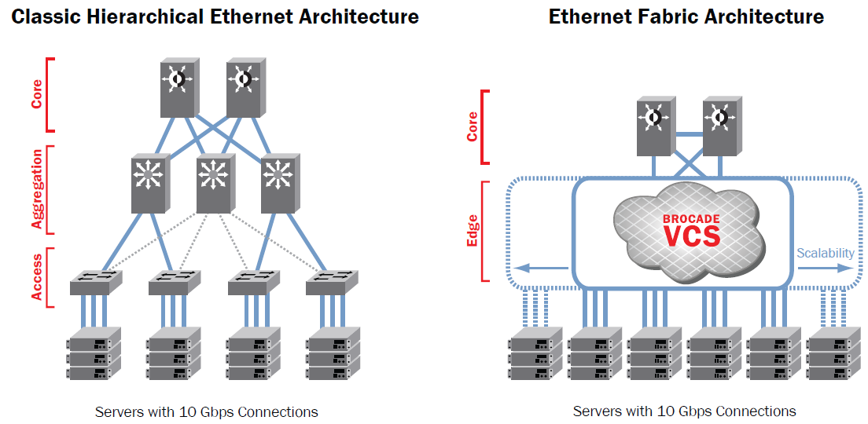

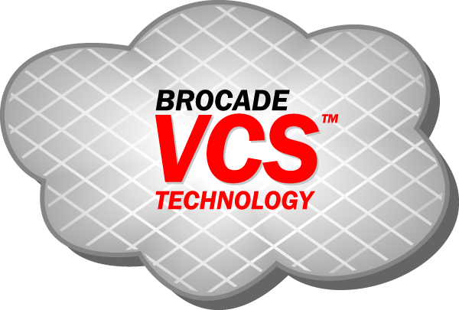



Ethernet Fabrics
Easing into a new A New Network Architecture
Hybrid Ethernet Fabric Architecture
Core
Aggregation
Access
Servers with 1 and 10Gbps Connections
Notes:
Key Points
Three-tier Ethernet networks have been successfully deployed in data center environments for the past few decades.
Now, a new type of data center network architecture is emerging called Ethernet Fabrics.
VCS is the leading Ethernet Fabric technology.
NO NEED TO JUMP IN THE DEEP END!
Dip your feet in the pool and enjoy

Slide 32
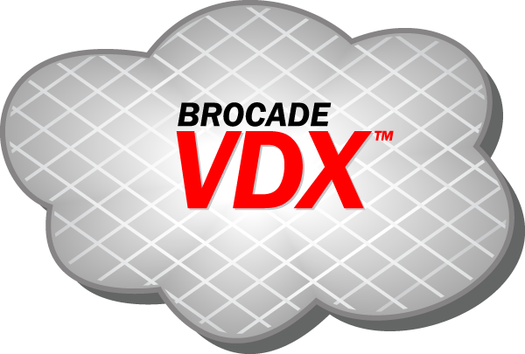

Migrating to an Ethernet Fabric
Seamless integration into existing environments
Core
Core
Aggregation
Combined Aggregation & Access
10 GbE & DCB
Access
1 Gb Ethernet
10 GbE or 10Gb DCB
Servers
10 GbE
iSCSI or FCoE Storage
Notes:
With Brocade VDX technology, you can bring in Ethernet fabric that accommodates your current networks and your future networks easy, whether data or storage.

Slide 33


Scaling Open Virtual Compute Blocks
Optimized for virtualized environments
VMware
VMware
VMware
VMware
VMware
VMware
VMware
VMware
VMware
VMware
VMware
VMware
Dell
HP
Dell
Dell
IBM
Dell
IBM
Dell
HP
IBM
HP
Dell
IBM
Dell
IBM
HP
Dell
Dell
VDX1
VDX1
VDX1
VDX1
VDX1
VDX1
VDX2
VDX2
VDX2
VDX2
VDX2
VDX2
NetApp Storage
(FCoE)
Dell Storage
(NAS)
EMC Storage
(iSCSI)
NetApp Storage
(NAS)
EMC Storage
(FCoE)
Dell Storage
(iSCSI)
Scalable with hundreds of thousands of VMs

Slide 34




Scalability and Flexibility of the Solution
Brocade and VMware: Optimizing Data Center Virtualization and Cloud Computing
BROCADE
VCS™
TECHNOLOGY
BROCADE
VCS™
TECHNOLOGY
Pods of servers with
10 x Rack Servers
2x Intel Xeon 4-core, 2x Intel Xeon 6-core
128 GB memory
Brocade 1020 CNA port (to iSCSI array)
Brocade 1020 CNA port (to LAN)
Desktop Pools
Desktop Pools
Desktop Pools
Desktop Pool
Desktop Pool
Desktop Pool
Virtual Cluster Switching
2x Brocade VDX 6720 Data Center Switch
24-port (24 POD-enabled)
VMware vSphere & View 4.6
VMware vSphere & View 4.6
VMware vSphere & View 4.6
3x iSCSI storage arrays
9.6 TB capacity per array
15K RPM SAS
4x 10 GB SPF+
Logical Storage Array
Logical Storage Array
Logical Storage Array
VDI Pod 1
1000 Virtual Desktops
+ VDI Pod 2
2000 Virtual Desktops
+ VDI Pod 3
3000 Virtual Desktops
N VDI Pod
N x 1000 Virtual Desktops
Notes:
One of our biggest added values in the solutions flexibility and scalability
Comparing with nCisco VCE for example where the serveres and storage are fixed here any Intel based server, and iSCSI storage will work.
We tested the building block that includes in one pod here, and the solution can expend horizontally by adding pods.
We tested dell 710 Rack server and the storage arrays are Dell equalogic

Slide 35

VCS Architecture

Slide 36

Brocade VM-Aware Network Automation Migration
NEW!
Dynamic configuration and secure communication
No need for manual configuration of MAC addresses and port profiles; less error-prone
Minimizes procedural delays between server and network IT teams
Eases configuration of multiple VCS fabrics
Protection against VM/MAC spoofing via secure vCenter communication
conf
vCenter
Brocade
Network
Advisor
VM
conf
conf
conf
conf
conf
conf
NAS
iSCSI
FCoE
FC
InfiniBand
iSCSI
Notes:
Second, it supports a fully distributed control plane. That means that every switch is aware of the entire network topology. I can configure it in a ring, a mesh, a tree.
I can configure enough links to make it entirely non-blocking or I can configure the topology to be over-subscribed at whatever level I choose. Every switch knows about every attached device and virtual machine. When a VM is attached to the network, the network configuration is automatically bound to the VM and then distributed throughout the VCS cloud. If the VM moves, the destination port already knows what to do and the VM is automatically reconnected to all of its old resources. The network configuration automatically migrates with the VM.
The products that implement this technology will initially support a mobility sphere of 1000 10Gig ports and 10,000 VM. The means that I can move a VM within a 10,000 VM sphere and everything happens automatically.

Slide 37

Brocade Network Advisor 11.2
AMPP Management
Comprehensive port profile life cycle management
  Tab views for easy navigation
  Port profile creation and change via CLI Templates
    Pre-defined templates for sub-profiles and profiles
Virtualization Management
  Easy association/disassociation of port profile and VM/MACs with any hypervisor
  vCenter integration allows users to associate VMware port groups to port profiles across fabrics and vCenter instances
  Profile comparison tools to ensure successful vMotion, even across fabrics
37

Slide 38
Reference VCS Fabrics Deployment Scenario’s

Slide 39

Brocade VDX with VCS Technology for ToR Server Access
WAN
Core
Brocade MLX with MCT
Aggregation
Existing 1 Gbps
Access Switches
vLAG
Brocade VDX
6710
Access
2-switch
VCS Fabric
at ToR
Brocade VDX
6720/6730
Servers
1 Gbps
Servers
1/10 Gbps
Servers
10 Gbps
Servers
1 Gbps
Servers

Slide 40
Brocade VDX with VCS Technology for Aggregation
1 GbE
10 GbE DCB
10 GbE
WAN
Core
Brocade MLX with MCT
LAG
Scalable VCS Aggregation
Aggregation
Brocade VDX
6720/6730
ToR Switch Stack
(Brocade FCX or other)
Existing Access Switches
Access
Servers
Existing 1 Gbps
Servers
New 1 Gbps
Servers
Notes:
Key Points
In this use case, VCS is used as an aggregation technology for 1 GbE server connections.
This gives the architect a building-block approach to network scalability, leveraging lower-cost switches at the aggregation layer.
Stackable 1 GbE switches are used at ToR, and those switches are connected into an Ethernet fabric.
This provides a 1-to-1 relationship between the access layer switches and the aggregation fabric, eliminating the need for STP and making all connections active.

Slide 41


Brocade VDX 6730 with VCS Technology for Native Fibre Channel Bridging
WAN
Core
Brocade MLX with MCT
Fibre Channel Storage
LAG
Fibre Channel Link to SAN Core
Edge
VCS Edge Fabric
Brocade VDX
6720/6730
Brocade VDX 6730
Access to Fibre Channel Storage
Servers
10 Gbps
Servers
Tier 1 Servers with 8 Gbps Fibre Channel
Notes:
Key Points
This is a network convergence use case.
Tier 1 applications still have native FC connections to the SAN for an air-gap, and to provide the highest performance and resilient connection to block resources.
Servers with CNAs can access FC and FCoE resources with a DCB connection from the Ethernet fabric into the core of the FC SAN.
In the future, core LAN routers will be able to have a connection into the core of the SAN.

Slide 42

24 Switch VDX Reference Architecture
10 G Server Access
MLXe with MCT
Total Bandwidth to Core: 160G
vLAG
16 Links per rack,
Total 10 racks- 160x10G per rack
VDX 6720-50x10G
6 –EW
4 –NS
4:1 Subscription
4 ECMP between
Inter-Rack Server
traffic
VDX 6720-40x10G
8 –NS
0–EW
4:1 Subscription
2 PORT ISL Trunk
20G B/W
VDX 6720-40 X 10G
Single Rack Solution
42U rack
Scale to addl.
20 Dual Homed
servers
10 Total Server Racks
2 Total VDX /Racks
320 Total Dual Homed
Servers
32 x 10G servers
32 x 10G servers
32 x 10G servers
32 x 10G servers
Rack 1
Rack 2
Rack 9
Rack 10

Slide 43

Something a little more traditional
– Fibre Channel
Notes:
[click]

Slide 44


Brocade DCX-Backbone Family
Product Highlights
Industry leading performance & scalability
  512/256 FC ports can operate at full 8 Gbps
  without congestion
  256 Gbps slot bandwidth plus local switching
  4.6/2.3 Tbps chassis bandwidth with Inter-Chassis Links (ICLs)
  ICLs save up to 64 ports for servers, storage, and switches
Best-in-class flexibility
  8-/4-slot models
  16-, 32-, 48-, and 64-port 8 Gbps blades
  FCoE, Encryption, Extension specialty blades
Highest availability
  Redundant, hot-swappable control processor, core switching, power and cooling
  Hot code load and activation*
Advanced functionality
  Integrated Routing, Virtual Fabrics, Top Talkers, and Adaptive Networking
Operational efficiency
  Highest power efficiency
  Back-to-front airflow
SAN Edge/Core
*Encryption blade requires a reboot
Notes:
44

Slide 45

Inter-Chassis Links (ICLs)
Scalability at the core
Brocade DCX
High-performance ports for connecting up to three Brocade DCX Backbones
  Four copper ICL ports per chassis
Preserves E_Ports for server, storage, or switch connections
  Brocade DCX: up to 64 8 Gbps E_Ports per chassis
  Brocade DCX-4S: up to 32 8 Gbps E_Ports per chassis
ICL ports
2-meter ICL cable
Notes:
Message:
DCX Backbones have special Inter-Chassis Links ports for connecting two backbone chassis using special ICL cables.
Coaching:
Use of ICLs requires an add-on license; different ICL licenses for DCX and DCX-4S models
Each DCX Chassis is a separate domain
ICL cables are currently 2 meters in length; considering longer lengths in the future

Slide 46


Backbone Topologies with ICLs
Multichassis configurations
Two backbones connected through ICLs (Fabric OS 6.0.x +)
Three backbones connected through ICLs (Fabric OS 6.3.x +, open systems)
Refer to Hardware Guide for Specific Connection Points
Notes:
46
Connect up to three Brocade DCX Backbones with ICLs
Achieve greater fabric consolidation and build more powerful core using Brocade DCX Backbones
3-way connection requires FOS 6.3 on all chassis available 9/14
Rules for 3-way DCX Backbone
All backbones must be connected to each other (single hop) in “triangular” topology
Each backbone must be connected to another using two ICL cables
Choice of license depends on mix of Backbone models
Supports FC, Virtual Fabrics; FICON support is TBD

Slide 47


Brocade Fabric-based Encryption
Product Highlights
Optimum flexibility
  Brocade FS-18 Encryption Blade for DCX
  Brocade Encryption Switch
  Integrated with RSA Key Manager, NetApp LKM, HP SKM, and Thales TEMs
Highest scalability
  Up to four blades per DCX chassis
Best-in-class performance
  Up to 96 Gbps encryption speed per switch/blade
  Up to 48 Gbps with tape compression
Maximum security
  AES 256-bit encryption
  FIPS 140-2 Level 3 validated
SAN Core/Edge
Notes:
47

Slide 48

Energy Efficiency: Going Green
 | Brocade DCX (512p x 8 Gbps) | Brocade DCX-4S (256p x 8 Gbps) | Brocade 48000 (384p x 4 Gbps) | Cisco* MDS 9509 (336p x 8 Gbps) | Cisco* MDS 9513 (528p x 8 Gbps)
Watts | 1,265 | 862 | 1,030 | 2,498 | 3,560
Cooling (BTU/hr) | 4,563 | 2,570 | 3,515 | 10,232 | 15,355
Watts/Port | 3.0 | 3.4 | 2.7 | 7.4 | 6.7
Watts/Gbps | 0.7 | 0.8 | 0.67 | 4.5 | 3.2
CO2 Emissions/yr metric tons | 5.6 | 3.2 | 3.8 | 9.2 | 13.2
  Brocade:
  Lowest power consumption
  Lowest heat output
  Lowest power per port
  Lowest power per bandwidth
  Lowest carbon footprint (CO₂)
Try the Power Consumption Calculator at www.brocade.com/power
Notes:
Message:
Brocade Switches have the lowest power consumption, cooling requirements, and carbon footprint among all competitive products
Coaching:
1 slide build
This slide expand discussion on energy efficiency to include cooling requirements and carbon emissions
While 48000 can deliver 8G performance, Watts/Gbps is based on 4G as most customer who would want full 8 Gbps capabilities across all ports would move up to DCX Backbone
Brocade’s New 8G switches are equally as energy efficient.
Cisco 9513 and 9509 #s based on new 8 Gbps blades.
Talk Track
This table fully outlines power consumption, cooling needs, and CO2 emissions for our DCX Backbones and 48000 director, as well as a competitive comparison.
Looking across our switch, director, and new backbone-class devices, Brocade consistently has the lowest…read green box.
You can prove this to yourself. We’ve created a power consumption calculator at the web address shown. You simply select a device – whether Brocade or from a competitor – populate it with desired blades using drag and drop, and in a couple of minutes you can compare detailed information on energy consumption and carbon emissions in an objective manner. It’s a great tool.

Slide 49




Brocade DCX Efficiency:
What does it mean to your data center?
With the power used by two 8Gb
MDS 9513s,
you could...
...run 2 DCXs + 2 racks of
EMC or HP modular storage
...run 2 DCXs and a fully loaded IBM or HP bladed server chassis
...run 6 DCXs
See the Brocade Power and Bandwidth Calculator for details

Slide 50
16G Fibre Channel
Brocade DCX 8510 Overview

Slide 51


Brocade 16Gb Family
DCX 8510-8, DCX 8510-4, Brocade 6510
DCX 8510-8 Backbone
  8.1 Tbps of Aggregate BW (2x existing DCX)
  512 Gbs Slot BW allowing to maintain similar over-subscription as today
  2 Tbps of ICL BW (4x DCX)
  Maintains same (1.5:1) over-subscription ratio with 16Gb 48P; 1:1 w/ local switching
  Similar changes for DCX 8510-4
Brocade 6510 Fabric Switch
  48 16 Gbps FC ports in 1U form factor (768 Gbps of aggregate bandwidth)
  Flexible and simple deployment
  2/4/8/10/16 Gbps FC and FICON
14U
Core Blades
CP Blades
9U
© 2010 Brocade Communications Systems, Inc. Company Proprietary Information
September 2010
51

Slide 52





Scale-Out Optical ICLs
Backbone scalability, performance, and reliability
Maximizes performance and scalability of SAN fabrics
  Connect up to six chassis (core-edge)
  Each ICL port delivers 64 Gbps (4×16 Gbps) bandwidth
  32 ICL ports per Brocade DCX 8510-8 chassis
  16 ICL ports per Brocade DCX 8510-4 chassis
  Up to 2 Tbps ICL bandwidth (four times existing)
  Up to 50 m universal optical cables
Minimizes latency between chassis
  Lowest-latency switching through the backplane vs. ISLs
  Does not count as a hop for FICON environments
Maximizes load balancing and availability
  Frame-based trunking is automatically enabled between four ICLs
  DPS distributes exchanges across all frame trunks
  If an ICL fails, traffic automatically flows over the remaining ICLs
8510-8 Core
8510-4 Core
New core routing blades with optical ICL ports
New ICL optics QSFP (4×16 Gbps)

Slide 53
In-flight Encryption over ISLs
Minimizes the risk of unauthorized access
Encrypts data on 16 Gbps ISLs
  Switch-to-switch encryption,
  not device encryption
  Useful over Fibre Channel long-distance links
Uses AES-GCM algorithm for both authentication and encryption
Uses 256-bit encryption key
Keys do not expire as long as the link stays active
New set of keys enabled upon port disable/enable
Port-level authentication must be enabled before enabling encryption
1$}~*,[£%^nt4@"
Unencrypted
Critical Data
1$}~*,[£%^nt4@"
Critical Data
Encrypted

Slide 54

IP Networking Solutions

Slide 55






Focus on Three Distinct Market Segments
Data Centers
Service Providers
Campus Networks
Notes:
< SLIDE HIGHLIGHT: Introduce the three major market segments that Brocade is focused on: Data Center, Campus Networks, and Service Providers >
The extraordinary network is designed to provide a broad set of characteristics that enable flexibility.
Because the requirements vary greatly in different parts of the network, we would not build the same type of solutions for a service provider network that we would build for a data center or campus network.
As a result, we have aligned the company to concentrate on three core market segments: the data center, campus networks, and service provider segments.
And, going forward, we will explain the technology drivers in those markets as well as the different types of products and solutions that fit into those segments.

Slide 56

Why Customers should buy Brocade IP
Up to 256 10GE or 1536 GE wire speed ports in a single chassis
15.36Tbps switch fabric capacity in a single chassis
100Gig available now
70Gbps Layer 4-7 throughput, 14 million DNS queries/sec
Faster
Cheaper
Smaller
Greener
Easier
10-30% CAPEX savings on equivalent solutions
30-50% OPEX savings on equivalent solutions
Higher density requires less chassis
Less chassis require less rack space
3 x less power for equivalent number of ports
3 x less cooling gives overall approx 6x more power efficient
One O/S across all storage products, One O/S across IP Products
Same CLI on IP products as Industry Standard

Slide 57


Key Features and Benefits
Maximize business operations and achieve tangible cost savings
Carrier-Ethernet Features
Carrier-Grade
High Availability
Massive
Scalability
Breakthrough Performance
Convergence-Ready
Virtual network services: Layer 2/3 VPN, GRE, VRF
Highly scalable IPv4/IPv6 routing protocols
Advanced QoS
Network security protection
Hitless failover and software upgrade
Nonstop routing
Redundant hardware
Instantaneous link or node failover
Over 30 Tbps dual-chassis bandwidth
Wire-speed
1536 1 GbE, 256 10 GbE, and 32 100 GbE ports
4.8 billion pps throughput
Capable of 7.7 billion pps throughput
Advanced features with no performance degradation
Lossless fabric architecture
Data Center Bridging (DCB)-ready

Slide 58





Brocade Data Center Networks
High-level architecture
1 GbE
4 Gbps FC
Core
10 GbE NetIron MLX
WAN
10 GbE
8 Gbps FC
Multi-VRF
10 Gbps CEE
10 GbE BigIron RX
10 GbE NetIron MLX
10 GbE L4-7 ServerIron
Tape Libraries
Aggregation
DCX Backbones
SAN
GbE ToR
FastIron Edge X
1/10 GbE ToR TurboIron 24X
1/10 GbE MoR
BigIron RX
GbE (VRF) ToR
NetIron CES
10 GbE ToR FCoE/DCB VDX/8000
Storage Arrays
Access
8/16 Gbps
DCX/5300/5100
NAS
Servers

Slide 59













Brocade Campus Networks
High-level architecture
100 MbE
Core
10 GbE
NetIron MLX
Data Center
100 MbE PoE
1 GbE
10 GbE
BigIron RX
1 /10 GbE
FastIron SX
WAN
1 GbE PoE
Aggregation
10 GbE
FastIron
SX1600 PoE
FastIron
SuperX PoE
FastIron CX
PoE+
FastIron
EdgeX PoE
Mobility Controller
Access
Devices
Surveillance Cameras
802.11n Access Point
(PoE+)
802.11g Access Point
802.11n Access Point
100 MbE and
1 GbE Devices
1 Gpbs
Powered Devices
Content-rich
Video
Notes:
To put these in context for you, down to core predominately would be the BigIron product family.
Aggregation will be the FastIron product family.
And the edge will be a combination of wireless and wired access technologies.
< MOUSE CLICK >
59

Slide 60


Application Delivery Enabling the Cloud
SERVERIRON ADX
Notes:
60

Slide 61

For the Enterprise
Sets the TCO bar
  Helping Enterprise data centers provision certified application delivery solutions for ERP/MRP, CRM, UC, and Security from Oracle, SAP, Microsoft, McAfee and others
  Best price/performance value per rack unit and per watt
  Best Layer 4-7 throughput, TPS/CPS, SSL, port density, and DoS server attack protection
Best futures and investment protection
  Industry’s highest application processor core and 10G port density across the broadest range of ADC form factors brings scalability and application capacity on demand to highly virtualized server environments
Notes:
61

Slide 62

ServerIron ADX and
Brocade Application Resource Broker
Bridging the gap between applications and infrastructure
Automation and orchestration of application
service delivery
Visibility and control over application infrastructure
Flexibility and choice in managing hybrid
cloud environments
Increased efficiency of application resources
Faster application deployment times and problem resolution
Tighter integration and interoperability with
third-party/custom management solutions

Slide 63
Simplified Orchestration and Management
Key enhancements in ARB version 1.5
Automated Provisioning / De-Provisioning
Ability to power off Virtual Machine (VM) when de-provisioning
Flexible Policy Management
Ability to configure a min/max limit for number of VMs per Virtual IP (VIP)
Enhanced Monitoring and Reporting
Predefined reports summarizing Application, VIP and VM activities
Ability to set a breach period for adding/removing VMs
Ability to add/remove VMs based on time of day or selected date range
Export of historical data in CSV/HTTP formats for use with third-party reporting tools
View of relationships between the ServerIron ADX > VIP > real server
/VM -> Host in the ARB management console
Quick access to the corresponding Performance stats for each of the linked app components listed above.
Ability to provision a new VM with selected ports enabled, consistent
with the application
Ability to select which ESX interface to use when provisioning
Ability to select which VM to activate when provisioning

Slide 64

Brocade Application Resource Broker
Brocade ADX Plug-in for vCenter Enables Private Clouds – Dynamic Apps
User
User
User
Application Resource
Broker
Application Resource
Broker
Application Resource
Broker
Brocade ADX
Application Resource Broker
VMware
vCenter
Brocade ADX
Brocade ADX
Network Resources
VMware
vCenter
VMware
vCenter
VM
VM
VM
VM
VM
VM
VM
VM
VM
VM
VM
VM
VM Resources
Application Resources
Resource
Commissioning When Load Increases
Resource
De-commissioning When Load Decreases
Application Resource
Monitoring

Slide 65

Case Study:
Brocade Application Resource Broker In Action
Financial Reporting Application
Application Load
(1) ADX monitors application performance by measuring application response time
Users
(2) End of quarter: Financial reports initiated across the company
(3) Load increases; VM1 response time goes up. ADX automatically redirects new requests to applications with faster response times
Brocade ADX
(4) Load increases further still.
Application Resource Broker alerts the operator and commissions additional VM’s from the shared pool
Application Resource
Broker
VM
VM
VM
VM
VM
(5) Earnings are announced; load on application decreases dramatically
Dedicated VMs
Shared Resource Pool
VMware
vCenter
(6) Newly created VM’s are decommissioned and released for use by other applications

Slide 66

IPv6-4 Application Delivery (SLB)
Quickly enable IPv6 web presence for your IPv4 applications
Brocade ADX offers translation service for IPv4 applications
  IPv6 VIP → IPv4 App Servers (v664)
  IPv6 VIP → IPv6 App Servers (v666)
  IPv6 VIP → IPv4 + IPv6 Servers (v664+6)
Additional capabilities for IPv6
  DoS attack (SYN attack) prevention
  Preservation of source IPv6 address
    Insert client IP into HTTP header
  Application-aware switching
IPv6 App Servers
IPv4 App Servers
Brocade ADX
IPv6
IPv6 Clients
Notes:
66

Slide 67

Brocade Network Advisor

Slide 68

Brocade BNA
Unified SAN (and IP) with adapter management
Unified management
Host-based discovery
Discovery of Brocade HBAs/CNAs
Host-based topology views
Server-to-adapter automatic mapping
Properties display
Events integration
Statistics collection and display
End-to-end operations
Adapter SupportSave
Deep element management HCM Launch-in-Context

Slide 69
SAN Offering
Feature
No Charge Version
Mid-Market Version
Enterprise Version
Number of Fabrics
1
4
24
Type of Fabrics Supported
FOS
M-EOS, FOS, Mixed
M-EOS, FOS, Mixed
Number of Ports
1000
2560
9000 (FOS); 5000 (M-EOS/Mixed)
4 and 8 Gbps Switches
Brocade 8000 / FCOE10-24
Brocade 7800 / FX8-24
Brocade 48000 Director
Brocade DCX-4S Backbone
HBA Management
Virtualization Support
Encryption (BES/FS8-18)
Real-Time Performance
Historical Performance
DBMS (ODBC & JDBC)
Partner Software Integration
Role Based Access Control (RBAC)
Call Home Support
FICON
Brocade DCX Backbone
Notes:
69
Version
1.0 dated 20080421
Main Message = This slide provides the high level value-proposition for HCM, and provides a preview of some of the features it enables (the next slide has more details). The key point to reinforce is that this HCM is the HBA “element” manager for basic HBA configuration and management. All the “End-to-End” features will be managed and configured through EFCM/DCFM. HCM allows storage admins to install the HBA, configure different HBA and port settings, and upgrade drivers and firmware. The HCM GUI can be installed on all the supported OSes and server platforms. In addition, the HCM GUI can be launched from EFCM/DCM as well as other 3rd party management applications. With a single user interface to manage all HBAs, storage and server admins can manage local HBAs (HBAs installed on same machine as GUI) as well as remote HBAs (HBA installed on distributed servers).
Questions?
Please send questions regarding this presentation to:
Tony Hampel (thampel@brocade.com) or Randy Narcisco (rnarciso@brocade.com)
Support
For any pre-sales support questions, or for help locating any resources cited in this presentation, contact the Wingman Helpdesk
Live by phone 6AM-6PM M-F San Jose time, +1 408 333 5959
By e-mail anytime @ wingman@brocade.com

Slide 70
IP Offering
Feature | No Charge Version | For Charge Version (Configurable)
# Devices | 20 | 5,000 | Max configuration
# Ports | 1,000 | Max | Max configuration
# MPLS | 0 | Max | Max configuration
Dashboard
Discovery of IP Products
Topology Manager
Fault Management
Configuration Manager
Change Manager
Performance Monitor
Reports
Administration/RBAC
MPLS Manager
Traffic Analyzer
ADP Management
Call Home support
= No
= Partial
= Yes

Slide 71


Brocade HCM
MANAGEMENT
Adapter element manager
Adapter management
SAN resource discovery
Driver/firmware updates
Multi-OS support
Easy access to HBA parameters
Monitoring and diagnostics
Scripting and automation
Logging and audit trail
Virtualization support
Beaconing of HBA/switch ports
Built-in supportability, SupportSave

Slide 72





Brocade Network Advisor
End-to-End Service Orchestration with Leading Partner Products
Open architecture with industry-standard APIs (SMI-S, Web Services, NETCONF, SNMP)
  Seamless integration with
    Orchestration Frameworks
    Security Partners
    Service Delivery platforms
VMware and Microsoft hypervisor plug-ins
NORTHBOUND APIs
NETWORK MANAGEMENT
LAN
Converged
SAN

Slide 73










Management Plug-In for VMware vCenter
Bridging operational gaps
VMware vCenter Server
Provide SAN visibility to VMware vCenter Admins
Fabric, network statistics sent to vCenter
Performance Thresholds and Errors
Enables VM-to-storage proactive port monitoring
Empowers vCenter administrators with bottleneck identification
Manage
VMware Infrastructure
VMware Infrastructure
Brocade SAN
Brocade SAN
Network Advisor
Notes:
73
Bridging the visibility and operational gaps between server/VM and storage admins by providing VM to LUN visibility into vCenter and allowing VM placement decisions that take the storage network path and its health into account
An oversubscribed link is reported in DCFM
DCFM tells VMware vCenter to migrate VM to new host
Benefits
Fabric, network statistics sent to vCenter
Policy-based management
Storage and network bottleneck identification
SAN and IP problem isolation
Physical path by VM identification
Automatic, or user intervention
73

Slide 74


SCOM Plug-in Dialog
Provide fabric inventory information in System Center Operations Manager (SCOM) plug-in
Management Pack retrieves the call home events from Network Advisor Server and periodically checks the health of Network Advisor
User has to register the SCOM Server to Network Advisor to receive the Fabric and Call Home events Details

Slide 75
Brocade’s HBA’s and CNA’s

Slide 76


Why Do We Offer Our Own HBA/CNA Products?
Because only Brocade HBAs/CNAs will extend Brocade’s Advanced Fabric Services and the DCF Architecture into the server
  This provides the necessary intelligence to gather and assess information, so that storage administrators can easily deploy and manage fabric data services
    Virtualization
    QoS
    Security
    Performance
    Manageability
Not only in the Fabric but at the host as well
Notes:
76
By extending its expertise from the fabric to the server interconnection, Brocade is able to execute a much more holistic approach to fulfilling virtualized next-generation data center requirements.
Vendors who only supply HBA products are not positioned to provide end-to-end management of the storage network and have control only over their own point-product functionality. For advanced DCF services such as data migration, virtualization, Quality of Service, adaptive networking, security and data encryption, Brocade’s comprehensive management of both fabric and HBA elements enables a much higher degree of stability, unified management and support.
At the same time, technical innovation of new storage services and capabilities is facilitated when both fabric and server components are brought under the same architectural umbrella. By introducing server connectivity solutions, Brocade can thus accelerate the development of new functionality that extends from the server interconnect to the storage port and optimizes our customers’ applications and storage environments.
… check out the HBA business case on the SRC [click]

Slide 77


Workloads with mixed I/O requirements
Guaranteed SLA for all workloads running on the host
End to End Quality of Service from VM to LUN
Discrete hardware I/O paths within the HBA allows VM I/O traffic prioritization within host server
Each discrete path has an associated Quality of Service (guaranteed bandwidth)
Enables mixed VM workloads with varying I/O requirements to share a single host without impacting service level
SQL Server
Exchange
Apache
QoS
Policy
QoS
Policy
QoS
Policy
QoS
Engine
Unified Management
QoS
Engine
QoS
Engine
Notes:
The benfits of NPIV in the virtualized data center
Quality of Service (QoS) to the VM
Easy Workload mobility
Granular security
Applications identified in the SAN
Better accounting
Flexible provisioning and upgrade
Better accounting
Since every I/O can be tied back to an individual VM, it is easier for the storage administrator to charge back the line of business owner of the Virtual Machine.
Quality of Service (QoS) to the VM
Since I/O requests originating from each VM can be identified on the fabric, they can be prioritized differently by the fabric switches allowing different QoS levels to be assigned to individual VMs.
Easier monitoring and troubleshooting
The same monitoring and troubleshooting tools used with physical servers can now be used with VMs, since the WWN and the fabric address that these tools rely on to track frames are now uniquely associated to a VM.
Flexible provisioning and upgrade
Zoning and other services are no longer tied to the physical WWN (hard-wired to the HBA), so it is easier to replace an HBA. You do not have to reconfigure the SAN.storage, because the new server can be pre-provisioned independently of the physical HBA WWN.
Workload mobility
The virtual WWPNs associated with each VM follow the VM when it is migrated across physical servers, No SAN reconfiguration is necessary when the workload is relocated to a new server.
Granular security
Access to specific storage LUNs can be restricted to specific VMs using the VM virtual port WWN for zoning, in the same way that they can be restricted to specific physical servers. (Note that ESX 3.5 still requires the physical HBA WWPN to be zoned with the storage WWPN.)
Applications identified in the SAN
Virtualized applications tend to be run on a dedicated VM, so the WWN of the VM now identifies the application to the SAN.

Slide 78


Virtualization Management Integration
VMware Awareness
VM inventory and detailed information
Virtualization support
Discovery of VMware ESX virtual machines via APIs
Part of host discovery
View VMs Properties
Display VM properties, including end-to-end path from VM to LUN
Virtual machine discovery
View VM LUN path information

Slide 79

Brocade Management
HCM & DCFM
Management
SAN resources discovery
Firmware/Driver Update
End to End QOS config
Multi-OS Support
Easy access to HBA parameters
Monitoring
Diagnostics
Scripting and automation
Logging and Audit trail
Virtualization Support (NPIV)
Beaconing (HBA and switch port)
Supportability built in (capture support info)
HCM
DCFM
Notes:
Main Message:
List some of the features of HCM.
Summary:
Brocade’s HCM enables server administrators to quickly configure Brocade HBAs, locally or remotely and to perform common monitoring and management tasks.
Key Points:
Brocade HCM offers both an easy to use graphical interface and a powerful command line interface for scripting and task automation.
SAN resources discovery: HCM automatically scans the SAN to discover visible storage resources and enumerate target LUNs.
Tree view: A navigation tree in the left pane provides quick access to the managed host HBAs, ports and target storage resources.
Easy access to HBA parameters: One single pane offers quick access to all HBA parameters at a glance.
Monitoring: HCM port statistics functions monitors HBA performance and traffic between the HBA and the attached LUNs to help isolate and troubleshoot areas that impact application performance.
Diagnostics: A battery of tests are available from the GUI and the command line to check the health of the HBA card, the optics and the physical link to the fabric.
Beaconing: Port beaconing for easy identification of HBA ports and link beaconing to identify the switch ports connected to the HBA.
Supportability built in: A single click save the current HBA and host configuration state into a file to help Brocade support troubleshoot problems remotely.
Scripting and automation: Brocade HBAs and Brocade switches share the same scripting engine enabling administrators to write powerful scripts to automate SAN configuration tasks end to end and to verify and enforce compliance with enterprise policies. All operations performed with the GUI can be scripted through the command line interface.
Logging and Audit trail: Operations are saved into a log and all events are displayed in the tool bottom pane.
Virtualization: Management of NPIV VPort from the GUI for use by virtual machine and applications. VPorts are represented in the left pane tree view for easy access and configuration.

Slide 80

10Gb FCoE CNA
Full performance server I/O Consolidation
Single chip, low power adapter solution
Dual port 10Gb CEE / 8G FC
  SFP+ and 10GBase-T models
Multi-function PCIe x8 2.0 Gen2
  Independent HPC, FCoE, Data PCI functions
  FC / Ethernet Virtual addressing
FCoE
  3rd Generation FC HBA, FC-SP Encryption
  Full FC protocol offload
HPC
  Low latency < 2us
Data
  Full functioning server NIC
  TCP/IP acceleration, RSS, jumbo frames, VLANs, Priority, Flow control, link aggregation
Converged Enhanced Ethernet
  Per Priority Pause (PPFC), Congestion Management (QCN)
Notes:
Main Message
The Brocade 10Gb CEE adapter preserves the host software and manageability model by providing separate independent PCI functions on a single card.
Summary
To the host Tomcat essentially looks like an independent NIC, storage adapter, and high performance computing adapter. This provides true physical I/O consolidation while maintaining the same manageability and usage model as adapters.
End users can enjoy the cost benefits of I/O consolidation without introducing complexity. The adapters support all the enhanced features for FC, Ethernet NIC server data networking, and low latency connectivity sharing one or two 10GbE ports.
CEE features on Ethernet adapters provide enhanced Ethernet features allowing high end data center applications (FCoE and HPC) to deliver acceptable data center and enterprise performance.
KEY POINTS
As a new entrant to this market, we took a clean sheet design approach
Our product was designed to minimize components (increasing RAS) and reducing manufacturing cost
We provide features tailored to high performance IO (FCoE), HPC (low latency messaging) as well as communications (TCP/IP).

Slide 81

Brocade 1860 Fabric Adapter
A new class of adapter for the cloud-enabled data center
FABRIC ADAPTER
HBA
CNA
NIC
Fabric Adapter: Extends Ethernet & Fibre Channel Fabric services
  Brocade Server Application Optimization (SAO): QoS, N_Port Trunking
  Brocade vFLink I/O virtualization, SR-IOV, VEB/VEPA
Brocade Any I/O technology
  16/8/4/2 Gbps Fibre Channel, 10 GbE Data Center Bridging (DCB), TCP/IP, FCoE, and/or iSCSI
  Configurable on a per-port basis
  All protocols supported concurrently, no licensing required

Slide 82
Brocade vFLink I/O Virtualization (IOV)
Adapter consolidation with granular control
Up to 16 virtual fabric links (vFLinks)
  8 PCIe Physical Functions (PFs) per port
    Fibre Channel: vHBA
    Ethernet: vNIC or vHBA (FCoE)
Appear as independent physical adapters to operating system
  No OS dependency, works today
  OS- and hypervisor-agnostic
  Access layer switch agnostic
Configurable bandwidth assignments
  100 Mbps increments
Consolidate multiple NICs and HBAs while maintaining isolation, QoS, and bandwidth allocations for different networks
VM1
VM2
VM3
VMn
Hypervisor
vSwitch
Kernel Storage IF
vNICs
vHBAs
Brocade 1860
Fabric Adapter
Console
Backup/iSCSI
10 GbE
16 Gbps Fibre Channel
10 Gbps
VM Migration
1 Gbps
6 Gbps
1 Gbps
3 Gbps
5 Gbps
Production
Tape Storage
Disk Storage
Ethernet Fabric
(VCS)
Fibre Channel
Fabric

Slide 83
Why Enterprises Choose Brocade
A trusted, strategic partner for networking products and complete end-to-end solutions
Comprehensive product and services portfolios
Extraordinary networks
to meet real-world requirements
Reduce IT Spend
Target 30
to 50%
COST
Open Solutions
World-Class Partners
CHOICE
SOLUTIONS
Leading Innovation
Your Timeline
Notes:
Key Takeaways:
Brocade is the best choice for customers based on real areas of value
Speaker Notes:
Why do customers choose Brocade?
First, cost is a big element today in IT budgets. Whether your budget's up or down, you have your budget, and you‘re looking for value. And when customers get that value, customers want to make sure that you have an innovation in technology that's going to give you investment protection.
Secondly, customers want to choose what vendors are in your network. You want to choose the solutions that you want. Customers want to make the decisions. They don't want vendors making the decisions for them.
Third, customers choose Brocade on total cost of ownership. Brocade provides the best solutions in the market today, and we give customers a choice.
83

Slide 84

Thank You

Slide 85






Brocade DCX Backbone Family
Fibre Channel port blade options
New 64-port 8 Gbps Fibre Channel blade, the industry’s highest-density port blade
  Leverages 8 Gbps SWL mini-SFP (mSFP)
  Universal Fibre Channel ports (E, F, FL, M, and EX)
48-, 32-, 16-port 8 Gbps Fibre Channel blades
  8 and 4 Gbps SWL and LWL SFPs; auto-negotiate slower speeds
  Universal Fibre Channel/FICON ports (E, F, FL, M, EX)
6-port 10 Gbps Fibre Channel blade for
dark fiber
Notes:
85
Message:
Modular architecture offers flexible – and common – blade options
Coaching:
Customer Requirements addressed by FC8-64
Need for Backbone-class availability
Reduced footprint
Need for cost effective server fan-in, with 8 Gbps performance and high port density per chassis
Slots available for intelligent/special purpose blades
Up to a 2:1 oversubscription is acceptable with a high port count (all ports 1:1 with local switching)
Both DCX and DCX-4S models use same blades; 48000 Director uses same FC port blades with exception of FC8-64 blade (not supported)
FC8-64 only supports FC ports using SWL mSFPs
F (FC node), FL, E (for ISL connection), M (Mirror port for out of band testing/traffic analysis), EX (integrated FC routing)
Integrated FC Routing - both models support up 128 EX_ ports; add-on license required

Slide 86

Brocade FX8-24 SAN Extension Blade
Replicate data across any distance
Optimum flexibility
  Twelve 8 Gbps Fibre Channel ports, 10 × 1 Gigabit Ethernet (GbE) ports
  Optional 10 GbE port upgrade with up to 20 Gbps bandwidth
  Up to four blades per Brocade DCX chassis
  Mainframe or open systems
Best-in-class performance
  Highest port density, bandwidth, and throughput
  Industry’s first and only 10 Gbps FCIP solution
  FCIP Trunking maximizes FCIP tunnel bandwidth
  Adaptive rate limiting and advanced compression optimize
  network resources
Value-added solutions
  Extends replication and backup over any distance
  Enables faster, more reliable data replication, backup, and recovery
Notes:
86
Main Message:
DCX delivers the fastest, most reliable, and most cost-effective network infrastructure for remote data replication, backup, and migration
Coaching:
A pioneer and leader in extending SAN fabrics over long distance
20,000+ extension systems deployed
25+ years of trusted leadership in mainframe environments
Most flexible network infrastructure
Replication, backup, and migration solutions
Entry-level to enterprise, point-to-point to multisite
Open systems and FICON, disk and tape storage
Port expansion and optional advanced functionality
Best-in-class performance and bandwidth over distance
The industry’s first and only 10 GbE FCIP SAN extension solution
Highest aggregate FC and FCIP bandwidth for blades
10x FCIP tunnel bandwidth (10 Gbps ports) vs. competition (1 Gbps)
4x FCIP tunnel bandwidth (4 Gbps ports) vs. competition (1 Gbps)
Up to 17,500 kilometers (nearly 11,000 miles) distance support
Highest availability and reliability
Redundant paths and lossless failover within an FCIP tunnel
Redundant, hot-swappable power and cooling
Industry-leading hardware reliability

Slide 87

Brocade FC SAN Extension
Product Highlights
Optimum flexibility
  Brocade FX8-24 Extension Blade
  Brocade 7800 Extension Switch
Best-in-class performance
  Highest port density, bandwidth, and throughput
  Industry’s first and only 10 Gbps FCIP solution
  FCIP Trunking maximizes FCIP tunnel bandwidth
  Adaptive Rate Limiting and advanced compression optimizes network resources
Value-added solutions
  Extends replication and backup over any distance
  Enables faster, more reliable data replication, backup, and recovery
SAN Core/Edge
Notes:
87

Slide 88


Brocade 8 Gbps Fibre Channel Switches
Product Highlghts
Best-in-class performance
  All FC ports can operate at full 8 Gbps without congestion
  Hardware-based, frame-level trunking
Best-in-class flexibility
  8-24, 24-40, and 48-80 port models
  Ports-on-Demand scalability
  Access Gateway mode (300/5100 models)
High availability
  Hot-swappable, redundant, load sharing AC power supplies and redundant cooling (5100/5300 models)
  Hot code load and activation
Advanced functionality
  Adaptive Networking and Top Talkers
  Integrated Routing, Virtual Fabrics, FICON (5100/5300 models)
  DCFM Professional included for multi-switch management
Operational efficiency
  Best-in-class power efficiency
  Back-to-front airflow
SAN Edge
Notes:
88

Slide 89




Brocade NetIron MLX Series Routers
Product Highlights
Leading performance and scalability
  Up to 15.36 Tbps forwarding capacity; 4.8 Bpps throughput
  Up to 1536 1 GbE, 256 10 GbE and 32 100 GbE ports
  Wire-speed, non-blocking performance
  Rear Exhaust airflow on all models
Optimum flexibility
  4-, 8-, 16-, and 32-slot chassis
  20-, 48-port copper and 20-port fiber 1 GbE modules
  4- and 8-port 10 GbE modules
  2-port CFP 100 GbE module
  4- and 8-port OC48 and 2-port OC192 modules
  DCB-ready
  Field-programmable packet processor
High availability
  Management, fabric, and M+N power redundancy
  Removable and load-sharing components
  MCT, Hitless failover and upgrade; graceful restart
Advanced functionality
  Virtualization through multi-VRF
  Multi-service feature set (IPv4, IPv6, MPLS)
  sFlow for granular network traffic accounting
Data Center Core/Aggregation
Notes:
89
Tbps is full duplex.

Slide 90


MLX 100G Module
Product Highlights
Industry’s first 2 port 100 GbE module
Massive 100 GbE density of 32 wire-speed ports
Terabit trunks with 1.6 Tb/s per trunk.
Ports on Demand enabling pay as you grow strategy
Classic XMR and MLX chassis support 1-port 100 GbE
Full featured card with Advanced MPLS and IPv4/IPv6 capabilities
1 million IPv4 and 240 K IPv6 FIB capacity
802.3ba compliant and supports CFP based optics
Backwards compatible with existing XMR & MLX interface modules
Field upgradeable programmable network processors
Notes:
Next-generation advanced core router for SP and DC networks

Slide 91


Brocade BigIron RX Series Switches
Product Highlights
Leading performance
  Up to 3.84 Tbps fabric capacity in a chassis
  Up to 768 1 GbE and 256 10 GbE ports
  4-, 8-, and 16-slot chassis
Advanced capabilities
  Advanced (IPv4/IPv6) Layer 2/3 feature set
  sFlow for granular network traffic accounting
  Fully redundant management, fabric, and M+N PSUs
  Removable and load-sharing components
  Hitless failover and software upgrade
Unparalleled Value
  Best-in-class power efficiency
  All features included in base software
Data Center
Access/Aggregation
Notes:
91

Slide 92



Brocade ServerIron ADX App. Delivery Controllers
Product Highlights
Leading performance and scalability
  70 Gbps L4-7 throughput
  16M L4 transactions/sec
  120M SYN attacks/Sec DoS protection
  14M DNS queries/sec
  320 Gbps switching
Optimum flexibility
  Fixed and chassis configurations with interchangeable modules
Advanced functionality
  Content switching and rewrite
  Transparent cache switching
  Hardware SSL acceleration
  TCP/HTTP multiplexing
  Multi-site redundancy using GSLB, FWLB
  VMware application provisioning
Data Center
Aggregation
Notes:
92
Brocade has large footprint with over 30% of modular L4-7 ports worldwide, and 10% of total L4-7 (2008 Del Oro). 3,500 plus customers and 50K+ units shipped since 1998.
ADX’s closes competitor is F5’s Viprion - kind of mini-rack with a power supply containing 4 stackable L4-7 switches. Cisco only offers a weak “ACE” module for Catalyst switches (well short in features/performance). Citrix doesn’t offer anything resembling a chassis.
In comparison to Viprion, Brocade ADX has:
2x 10Gig density
2x Application core density
60% greater L4 connections rate
4x the L4 transaction rate
5x the DoS and SYN attack protection rate
4x the concurrent session capacity
3x the DNS queries/sec
Lowest cost/transaction
Lowest cost/Gbps throughput

Slide 93




Brocade NetIron CES Series Switches
Product Highlights
Data center-class performance
  DC modularization with GbE ToR solution
  Wire-speed performance; 48-136 Gbps
  128,000 MAC addresses, 32,000 IPv4 routes
  Deep packet buffers; low latency
  Front-to-back airflow
Best-in-class flexibility
  24- and 48-port copper and fiber models
  Field-upgradable to 2-port 10 GbE
High availability
  Designed for NEBS Level 3 compliance
  Hot-swappable, redundant, load sharing AC/DC power supplies
  N+1 redundant, replaceable cooling system
Advanced functionality
  Virtualization through multi-VRF
  Full IPv4 unicast & multicast capabilities
  Advanced QoS capabilities
Data Center Access
Notes:
93

Slide 94




Brocade FastIron CX Series Switches
Product highlights
Highest PoE+ port density in a stackable design
  Up to 48 PoE or 26 PoE+ ports in 1U
  Up to 384 PoE or 208 PoE+ ports per stack
Optimum flexibility and high availability
  PoE+, non-PoE+ and 24 fiber ports models
  All models support four 100/1000 MbE fiber uplinks
  All models are field-upgradable to 2-port 10 GbE
  Dedicated 64 Gbps stacking bandwidth (FDX)
  Redundant, removable, load-sharing power supplies
  Hot unit insertion/removal from the stack
  Cross-unit link aggregation
  Single IP management
Advanced VoIP software features
  Dynamic voice VLAN and QoS configuration
  Dynamic power management through LLDP-MED
  Robust security suite
  sFlow for granular network traffic accounting
  Support for variety of 802.3af and 802.3at devices
  Support for full Layer 3 features and routing
Data Centre edge or Campus Access

Slide 95



10 GbE Fixed Port Data Center Portfolio
 | Brocade 8000 | Brocade TurboIron 24X | Brocade VDX 6720
Positioning Statement | 10 GbEswitch targeted at server I/O consolidation. Splits IP and FCoE traffic at ToR. | 10 GbE switch with a rich set of L2/L3 features targeted at the cost-optimized ToR market. | 10 GbE switch, delivering VCS, targeted at virtual data centers. Enables end-to-end LAN/SAN convergence.
Use Cases | 10 GbE ToR server access Server I/O consolidation Direct attach to storage | 10 GbE ToR server access L3 services to the edge 10 GbE aggregation (L3) | 10GbE ToR, L2 agg. Large-scale virtualization LAN/SAN Convergence
Competitors | Cisco Nexus 5010, 5020 | Arista 7100 series Juniper EX2500 HP ProCurve 6600 Blade G81xx | Cisco Nexus 5010, 5020 Juniper EX4500 Arista 7100 series
Complementary Products | 1010/1020 CNAs DCX FCoE Blade | FCX, CES MLX | 1010/1020 CNAs MLX Future VDX products

Slide 96


Brocade FastIron WS Series Switches
Product highlights
SMB/SME convergence solution
  Up to 48 10/100 or 10/100/1000 MbE PoE ports in 1U
  Up to 48 Class-2 PoE or 27 full Class-3 PoE ports
Cost-effective flexibility
  Cost-effective 10/100 or 10/100/1000 MbE models
  PoE and non-PoE models
  All models support four 100/1000 MbE fiber uplinks
  Support for external power supply redundancy
Advanced VoIP software features
  Dynamic voice VLAN and QoS configuration
  Dynamic power management through LLDP-MED
  Robust security suite
  sFlow for granular network traffic accounting
  Support for variety of 802.3af devices
Campus Access

Slide 97



Brocade FastIron SuperX/SX Series Switches
Product highlights
Highest PoE port density in a chassis
  Up to 384 10/100/1000 MbE PoE ports
  Up to 400 1 GbE or 36 10 GbE ports
  Wire-speed performance
Optimum flexibility
  8- and 16-slot chassis
  24-port copper and fiber 1 GbE modules
  2-port 10 GbE modules
  PoE field-upgradable 24-port modules
  Support for LAN and WAN PHY on 10 GbE modules
High availability
  Separate system and PoE power subsystems
  Management, fabric, and N+1 power redundancy
  Removable and load-sharing components
Advanced, scalable software features
  Dynamic voice VLAN and QoS configuration
  Dynamic power management through LLDP-MED
  Robust security suite
  sFlow for granular network traffic accounting
  Full Layer 3 IPv4 and IPv6 features and routing
Campus
Access/Distribution

Slide 98



PERFORMANCE LEADERSHIP
For Scalability
  70 Gbps Layer 4-7 throughput
  16 million Layer 4 transactions/sec
  120 million SYN/Sec DoS protection
  230,000 SSL TPS
  14 million DNS queries/sec
  320 Gbps switching fabric
  High-density 16 x 10 GbE ports and the only 10 GbE-capable 1U ADC
  Up to 32 processor cores
For Greatest Flexibility
  Fixed and chassis configurations with interchangeable modules
For Advanced Functionality
  Content switching and rewrite, Transparent Cache Switching, hardware SSL acceleration, and TCP/HTTP multiplexing
  GSLB and FWLB
Notes:
98
98
98
ADX outperforms the best of the competition, shown in these highlights.
ServerIron ADX provides the industry’s highest-density L4-7 switching in a fixed or modular design, and they support a complete line of L4-7 advanced application delivery features.

Slide 99















Brocade Mobility Product Line
Wireless Access Points
Wireless Controllers
Ethernet Switches
Brocade Mobility 650 Access Points
Brocade Mobility RFS7000 Controller
Brocade FastIron CX
Brocade Mobility 6511 Access Point
Brocade Mobility RFS6000 Controller
Brocade Mobility 7131 Access Points
Brocade Mobility RFS4000 Controller
Brocade FastIron SX
Network Management
Live RF
Forensics
Spectrum Analysis
Diagnostics
AirDefense Enterprise – Wireless Intrusion Prevention

