Slide 1
Cooperation, Collaboration & Consolidation
CRICOS No. 00213J

Slide 2
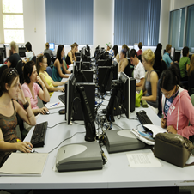
An imperfect process
  All software requests must be collated
  Last minute re-imaging of labs/MELTS
  EVERY software request is on the critical path
  Late software requests difficult to accommodate
  Changes to the images difficult to accommodate
  Staff Burnout

Slide 3
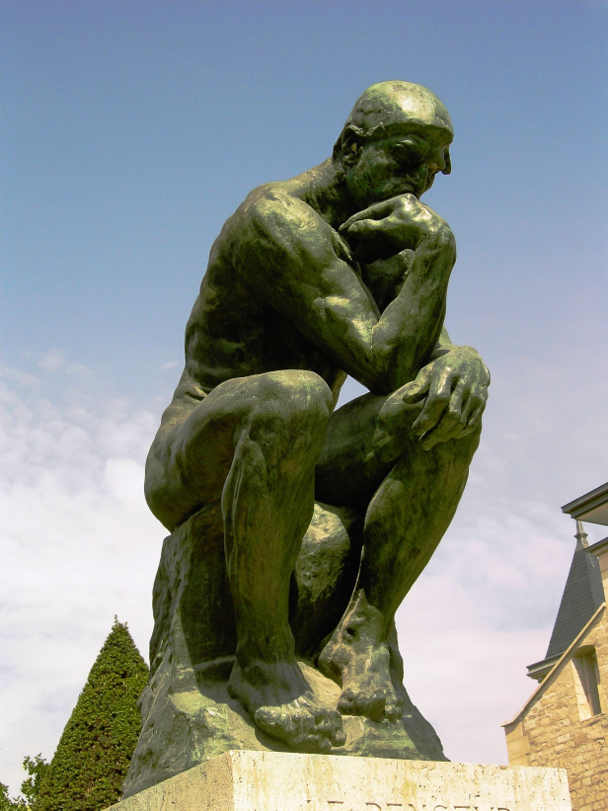
Addressing the Problem
How do we manage the labs and MELTS for 40000 students, 5000 staff and keep the environment well maintained?
How do we provide applications and updates in a responsive way?

Slide 4

The Approach
Work smarter not harder
Use common technology across staff and student spaces
Well managed environment
Dynamic updating & software installation
Staff input to process
Improved Lab team work practices

Slide 5
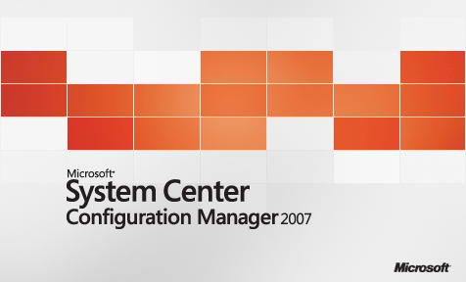
Technologies to use..
SCCM
  Automatic OS installation
  Package installation
  Windows configuration
  Repeatable configurations
  Automated configurations
  Hardware independent

Slide 6
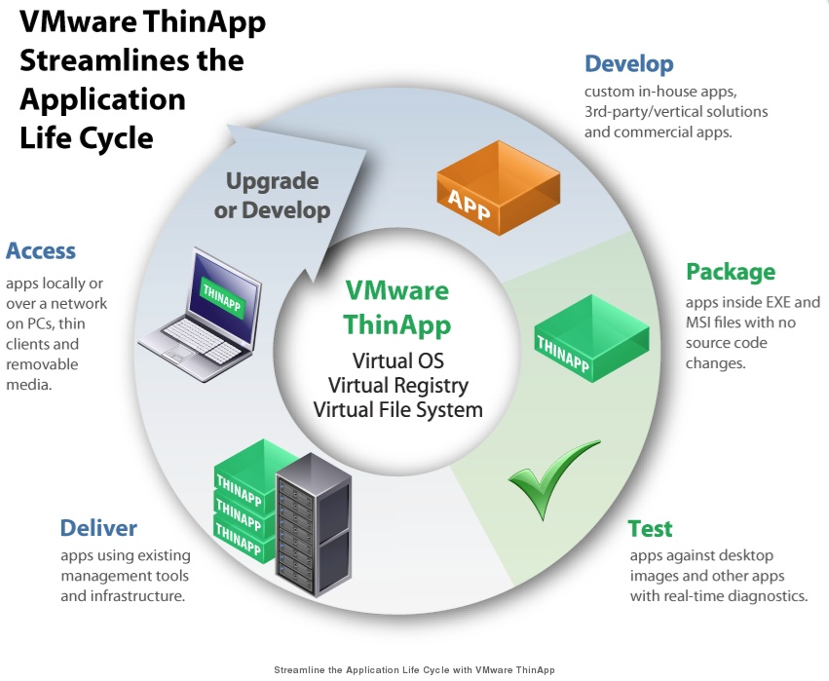
Technologies to use..
  Virtual Applications
    Vmware ThinApp
    Microsoft App-V
  Automated Installs
    ‘Hands off’ installation
    Silent

Slide 7

Technologies to use..
VPro
Every machine connected to power & a network port is manageable, whether switched on or not.

Slide 8

Technologies to use.. (student labs only)
‘Reboot to restore’
Allows users to be administrators. Changes are removed at next boot.
Reduces support calls/costs to fix incorrect configuration changes
Prevents dynamic updating (unless thawed)

Slide 9
Challenges for the new direction
Approx 650 applications
Printer drivers and Windows 7 64-bit
New Director

Slide 10
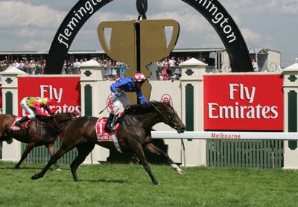
Challenges – The Melbourne Cup Day Incident
Note to self: SCCM OSD is very very very very very very efficient.
Be very very very very very very very very very careful!

Slide 11
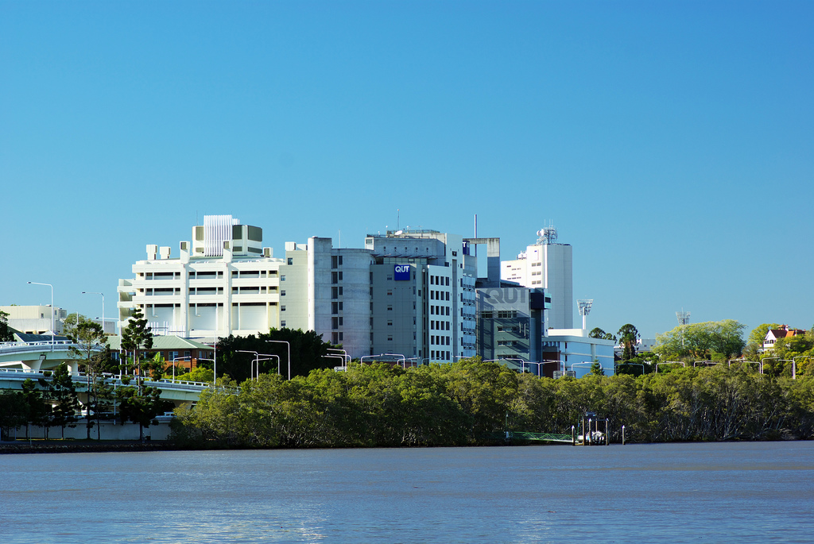
Expect the unexpected

Slide 12
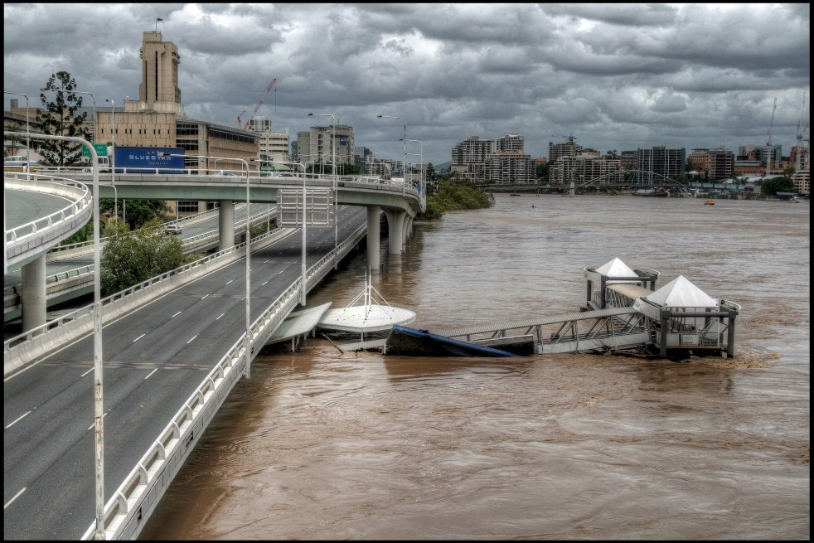

Slide 13
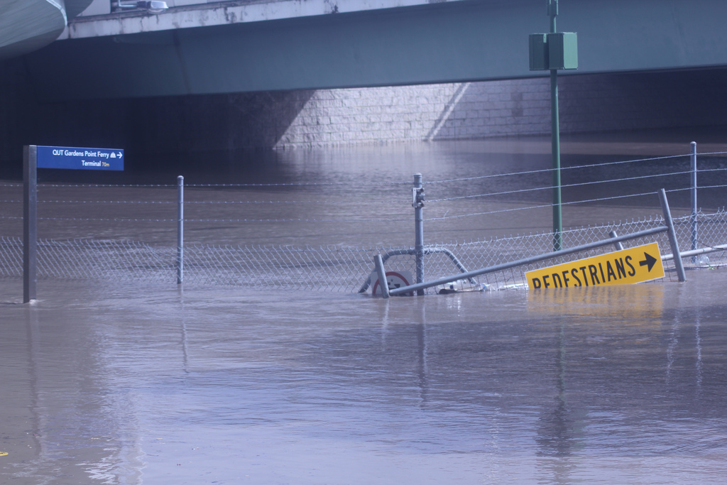

Slide 14
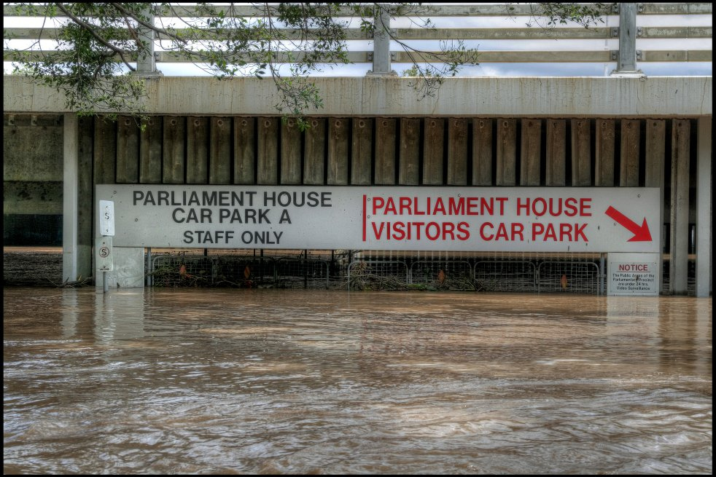

Slide 15

Semester 1 2011 success !!
SCCM much more robust than previous solution
Greater cooperation from ITS departments in troubleshooting
By week 1,all labs deployed less BEE Faculty labs by request

Slide 16
Post-install challenges
IE default security settings higher than expected on internal sites
Thinapp Firefox unstable with some filetypes
Slow logins
Printer mapping inconsistent

Slide 17
Current status
  Well managed environment
    Security updates / non-critical applications applied during regular maintenance
    Urgent applications can be installed immediately (30 minute max contact time)
  Teaching staff
    Call for software no longer required
    Existing packages deployed within 24 hours
    Applications requiring packaging 1-2 weeks lead time
  LE staff
    No start of semester panic – planned rollout of applications, not images
    Able to be responsive to changes
    Work/life balance

Slide 18
Thankyou
For more information:
Phillip Kent p.kent@qut.edu.au
Adrian Whitaker a.whitaker@qut.edu.au

