Slide 1
MOE – Experience
What do you get
It just works
Same look and feel across the university
Your documents and desktop available where-ever you login (redirected to your home share on eStore and made available offline)
ITassist
Request Admin Rights

Slide 2
MOE – What do you get
MOE Base
Windows 7 enterprise 64-bit with service pack 1
Microsoft Office 2007 with SP2
Microsoft security and non-security updates
.net framework 4.0
QUT ITassist

Slide 3
MOE – What do you get
MOE Base - continued
Mozilla Firefox 3.6.22
VLC 1.1.11
Adobe Reader 10 and Flash 10
Java Runtime Environment 6 update 26
Sophos EndPoint Security & Control 9.7

Slide 4
MOE – What do you get
Staff specific applications
Microsoft Live Meeting
Microsoft Office Communicator 2007 R2
Symantec Enterprise Vault 9.0.1

Slide 5
MOE – It just works (on supported Hardware)
Laptops will automatically connect to the QUT WIFI network prior to logging on to the domain using your supplied credentials
On the Windows XP SOE you would have needed to plug in an Ethernet cable in order to logon to the domain and manually configure the wireless settings

Slide 6
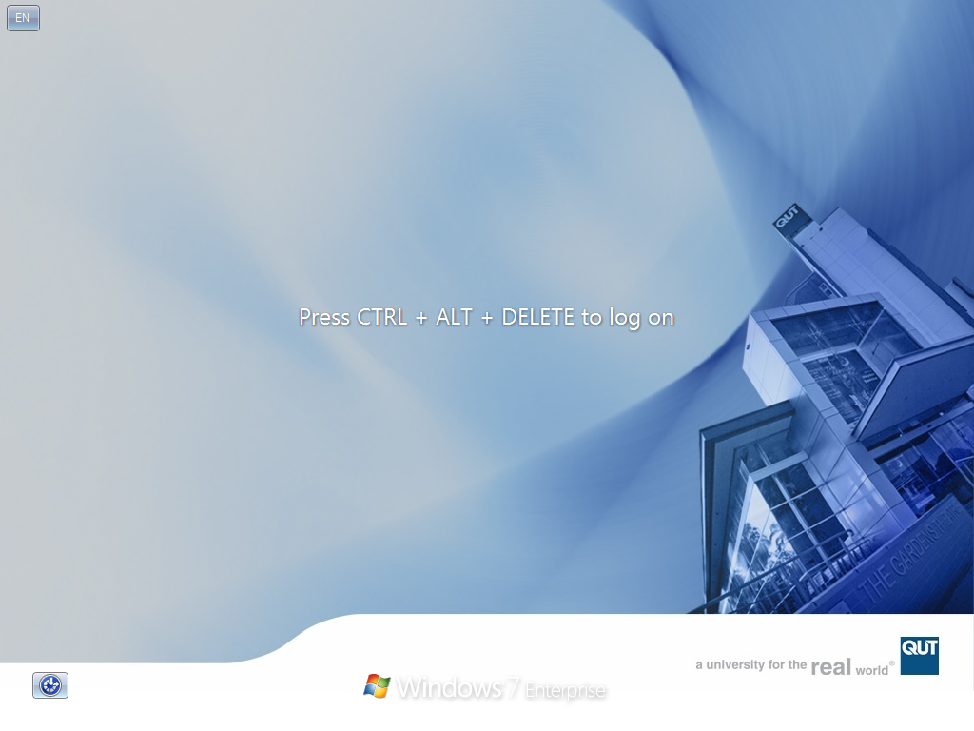
MOE – same look and feel

Slide 7
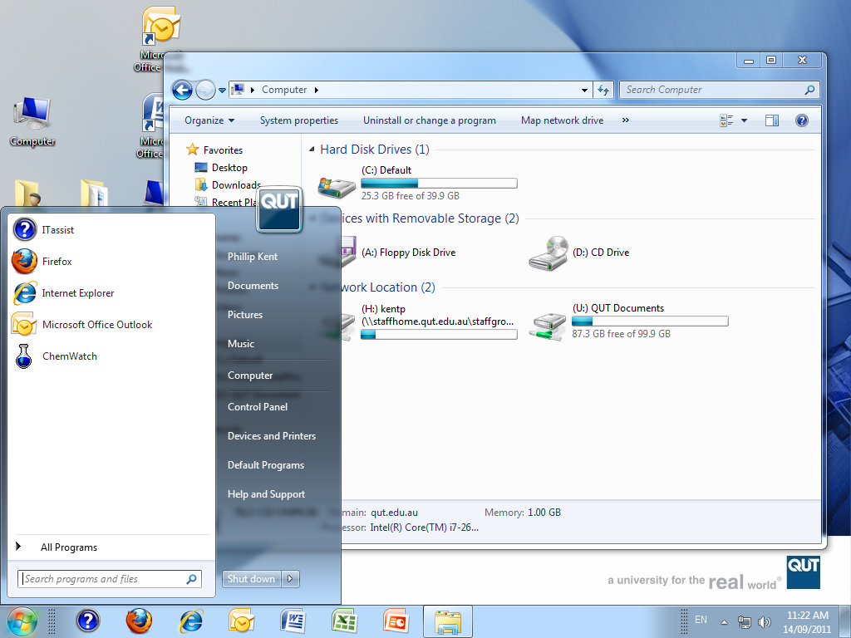
MOE – Desktop and Documents

Slide 8
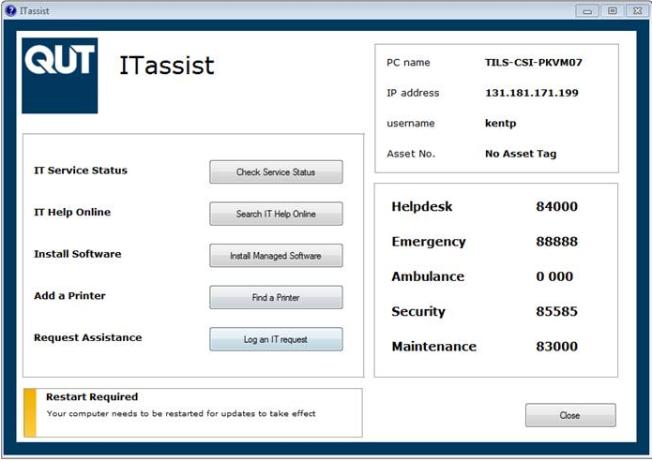
MOE – ITassist

Slide 9
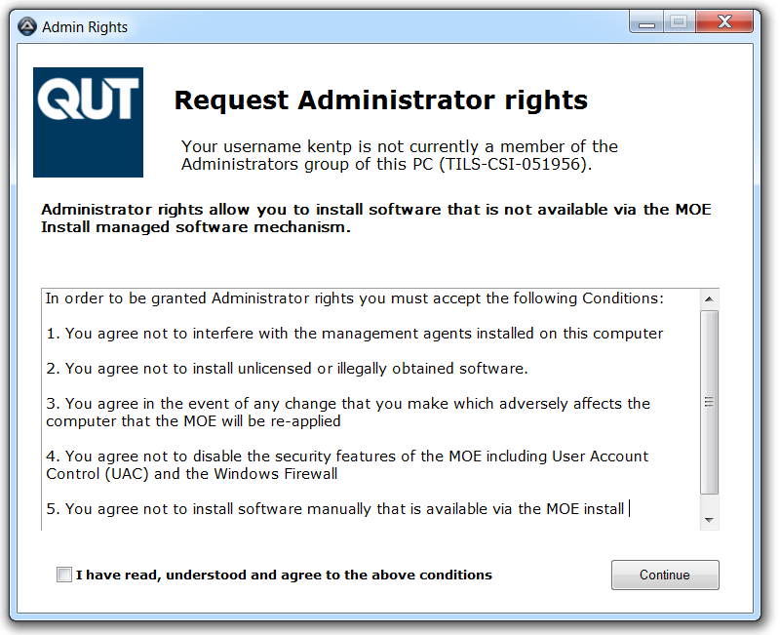
MOE – Request Admin Rights

Slide 10
MOE – Admin Rights - Why
Clients are able to install non managed applications when they need to
Applications launch by default with low rights instead of all applications running with full Administrator rights on XP
We have a record of who requested admin rights
Clients documents and desktop folders are redirected to their home drive (eStore)
Easy to re-apply the MOE

Slide 11
MOE – The 3 ways to get the MOE
New computer for a new Staff member
Existing computer to the Win 7 MOE
Machine replacement – old PC to new PC

Slide 12
MOE – Scenario 1.
New computer for a new Staff member
Connect the PC to the QUT network and boot
Select Install the MOE on a New Computer task sequence
Enter the computer name when prompted
Come back in half an hour
Demonstrate ITassist and QUT Documents (U: drive) to the client

Slide 13
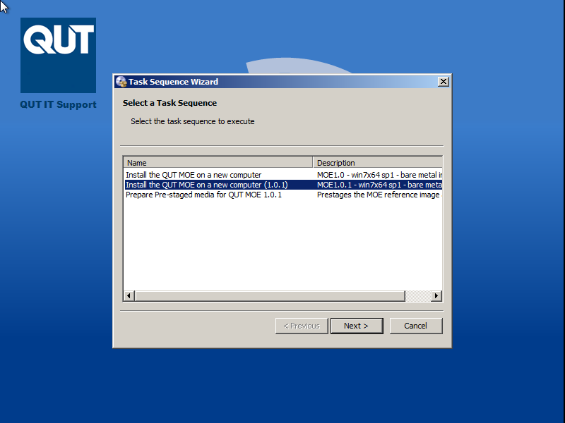
MOE – Scenario 1 – Select Task sequence

Slide 14
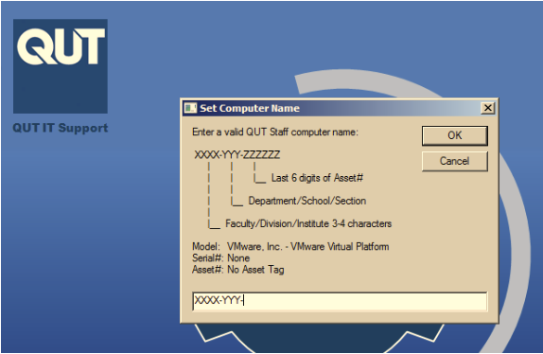
MOE – Scenario 1 - Set Computer Name

Slide 15
MOE – Scenario 1 – Task sequence complete
Some time later...
(21 minutes for a Dell Optiplex 990)

Slide 16
MOE – Scenario 1 – Task sequence complete

Slide 17
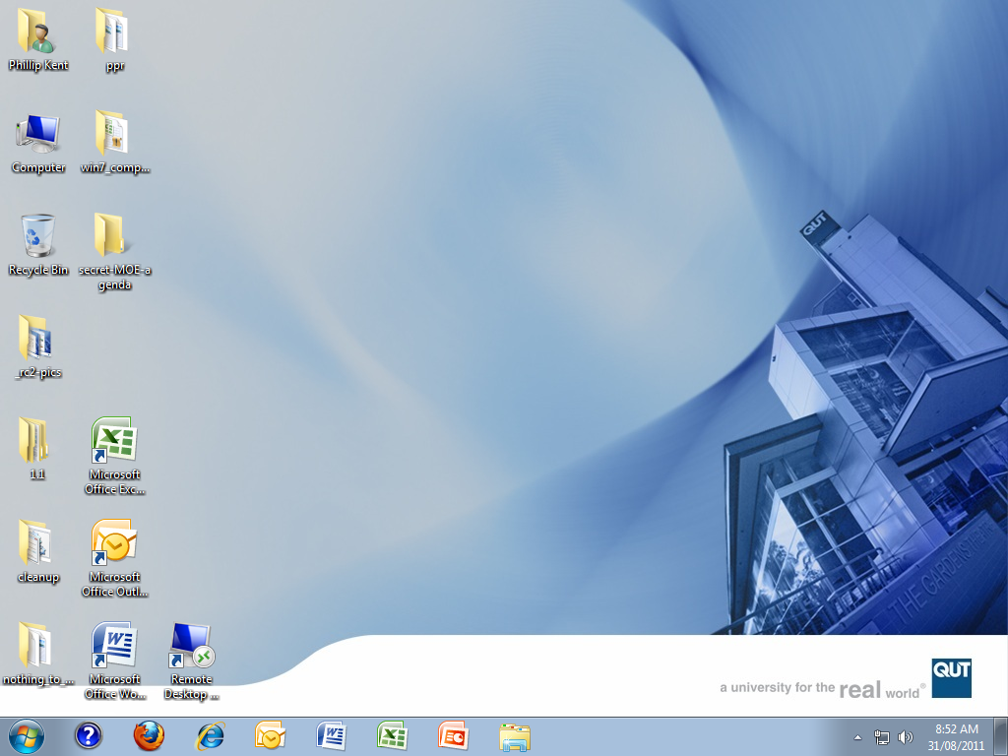
MOE – Scenario 1 – Desktop for a logged in user

Slide 18
MOE – Scenario 2.
Existing PC to Win 7 MOE
Run the Start the in-place migration to the MOE task sequence from Run advertised programs
Check the MOE migration Pre-flight check tool results
Backup C:\ drive to VHD file if required and continue
Ensure that the USMT capture process completes and starts the MOE installation
Come back later

Slide 19
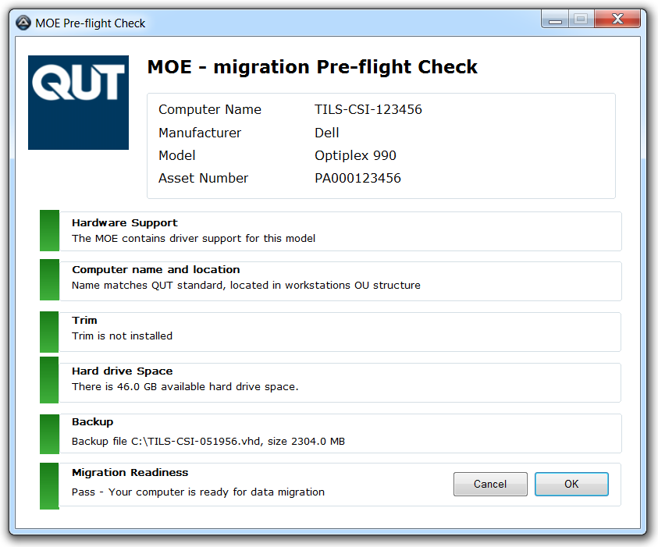
MOE – Scenario 2.
Existing PC to Win 7 MOE – Good to go

Slide 20
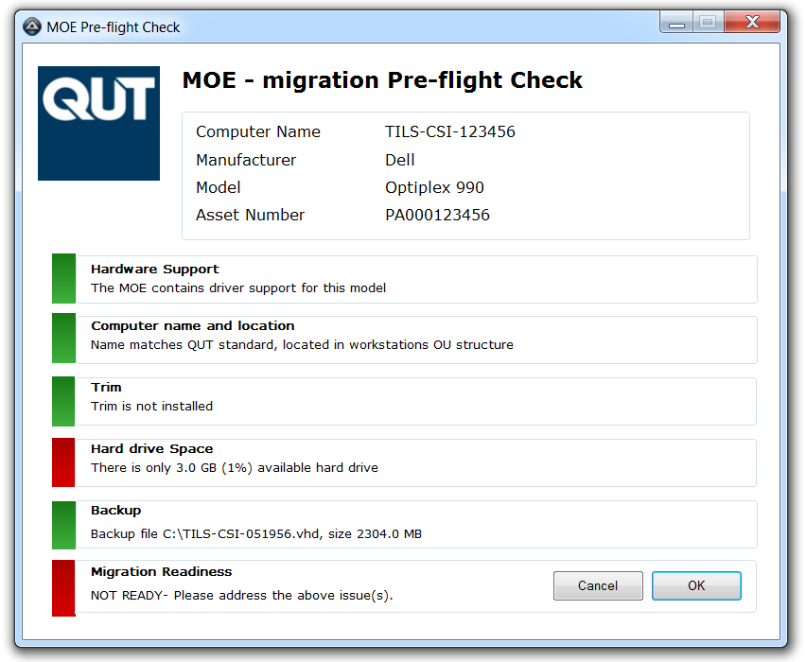
MOE – Scenario 2.
Existing PC to Win 7 MOE – Not so good

Slide 21
MOE – Scenario 3 – Machine replacement
Part 1 (on the old PC)
Run Start the migration to a new computer task sequence from Run advertised programs
Pre-flight check tool will run – ensure good to go
Ensure that the USMT process completes successfully.
Shutdown the PC

Slide 22
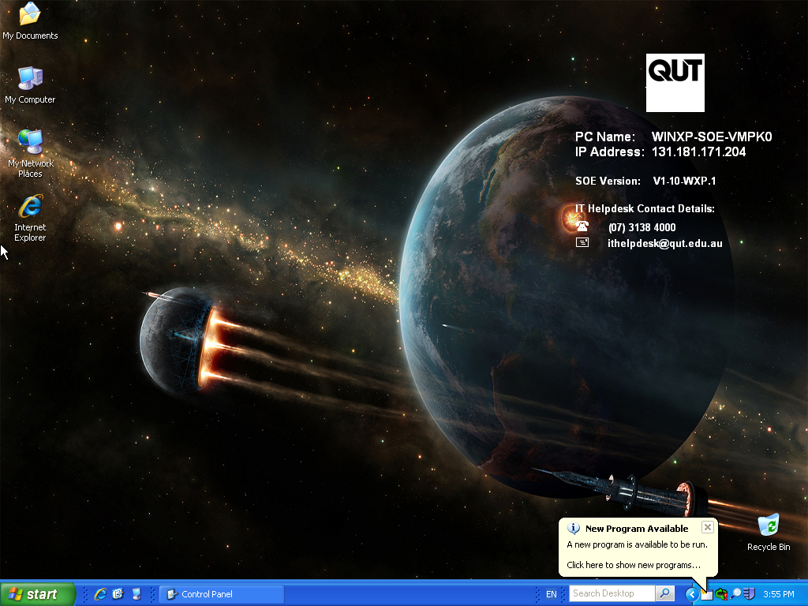
MOE – Scenario 3 – Machine replacement
Part 1

Slide 23
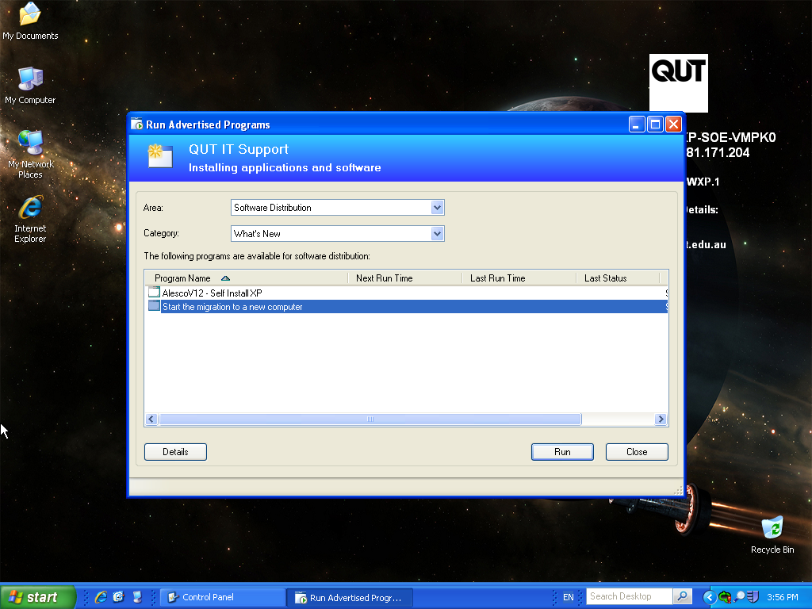
MOE – Scenario 3 – Machine replacement
Part 1

Slide 24
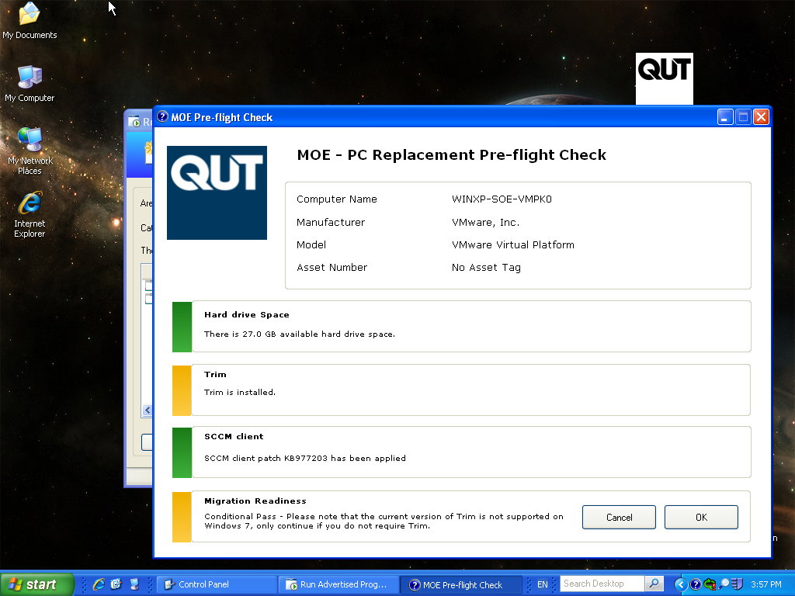
MOE – Scenario 3 – Machine replacement
Part 1

Slide 25
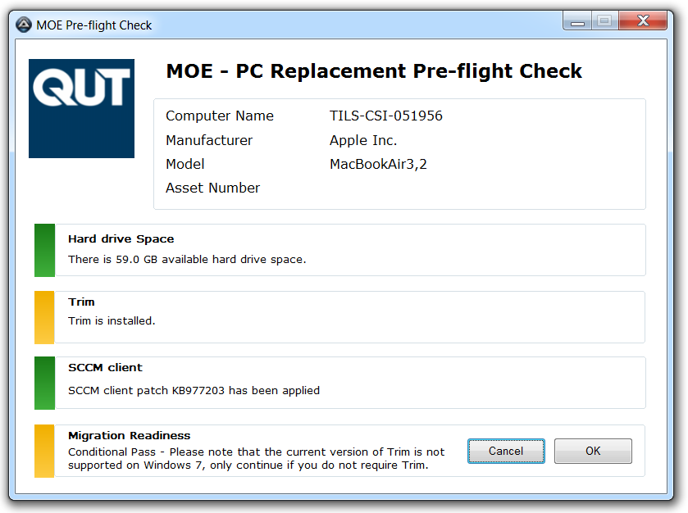
MOE – Scenario 3 – Machine replacement
Part 1

Slide 26
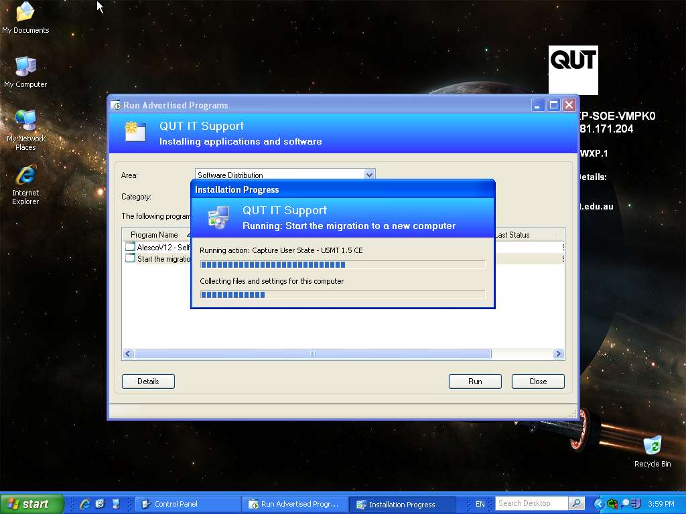
MOE – Scenario 3 – Machine replacement
Part 1

Slide 27
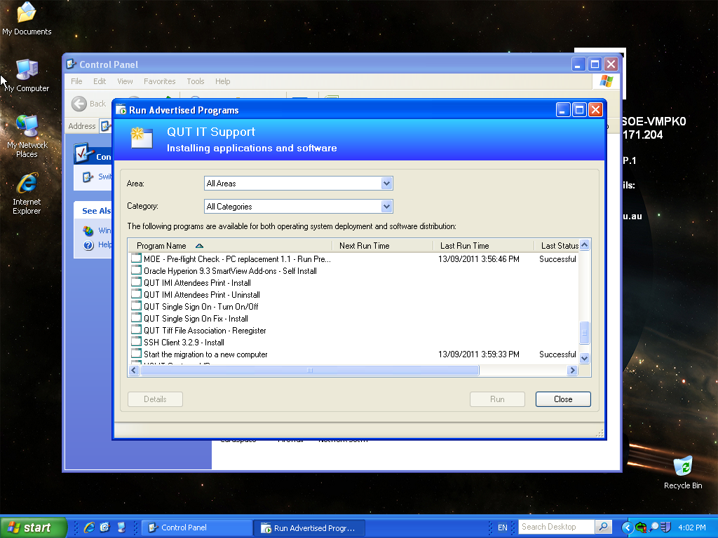
MOE – Scenario 3 – Machine replacement
Part 1

Slide 28
MOE – Scenario 3 – Machine replacement
Part 2. (On the New PC)
Connect the clients new PC to the QUT network and boot
Ensure that the task sequence starts
Come back in half an hour
Demonstrate ITassist and QUT Documents (U: drive) to the client

Slide 29
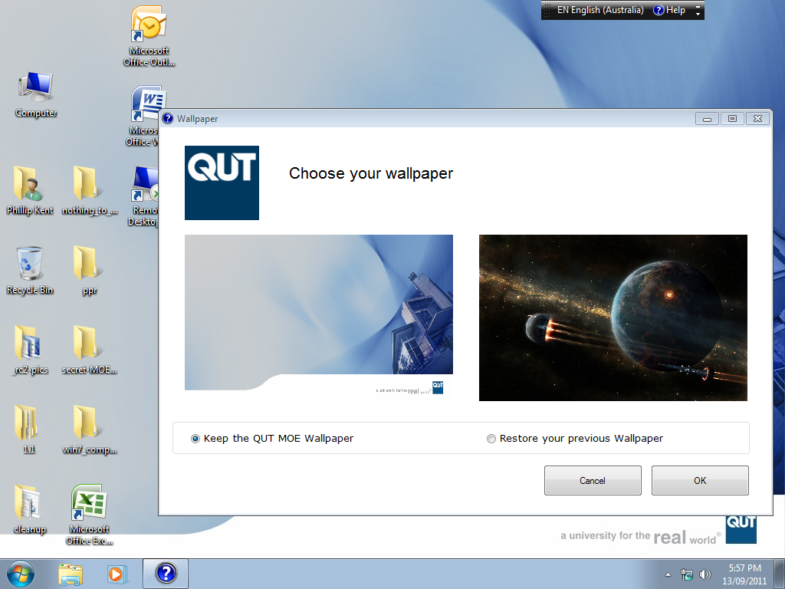
MOE – Scenario 3 – Machine replacement
Part 2

Slide 30
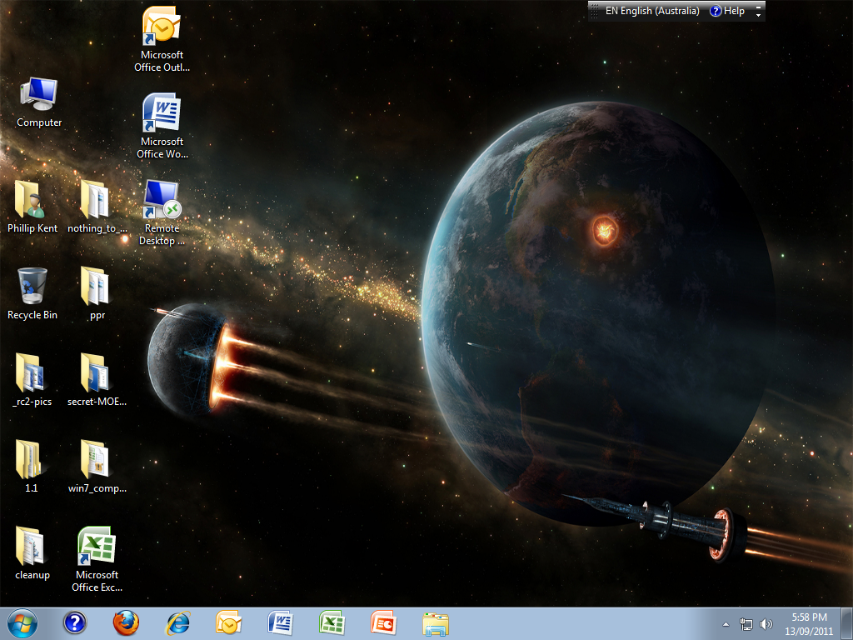
MOE – Scenario 3 – Machine replacement
Part 2

Slide 31
MOE
Why you should use the MOE
How – Tools & Technologies
What – Experience and 3 ways to get the MOE
Tips and Tricks
Thanks

Slide 32
MOE – Tips and Tricks
Press F8 on the MOE Boot disk to launch a command prompt
Make sure that the computer object in AD is deleted if you are reimaging a PC with the QUT MOE.
If you are trying to install the MOE on VirtualBox make sure that you set the virtual harddrive to IDE not the default of SATA and have a minimum of 40 GB
Trace32.exe – SCCM log tracing tool is your friend

Slide 33
Supported Hardware
Windows 7
  Check the Windows 7 Supported hardware page
Windows XP
  Desktop: Dell Optiplex 990 8 Gb RAM, discrete graphics, I7 processor
  Laptop: Toshiba Portege R830 (13.3 inch)
  Dell Latitude E6320 (13.3 inch)
  Dell Latitude E6520 (15 inch)

